Slide 1
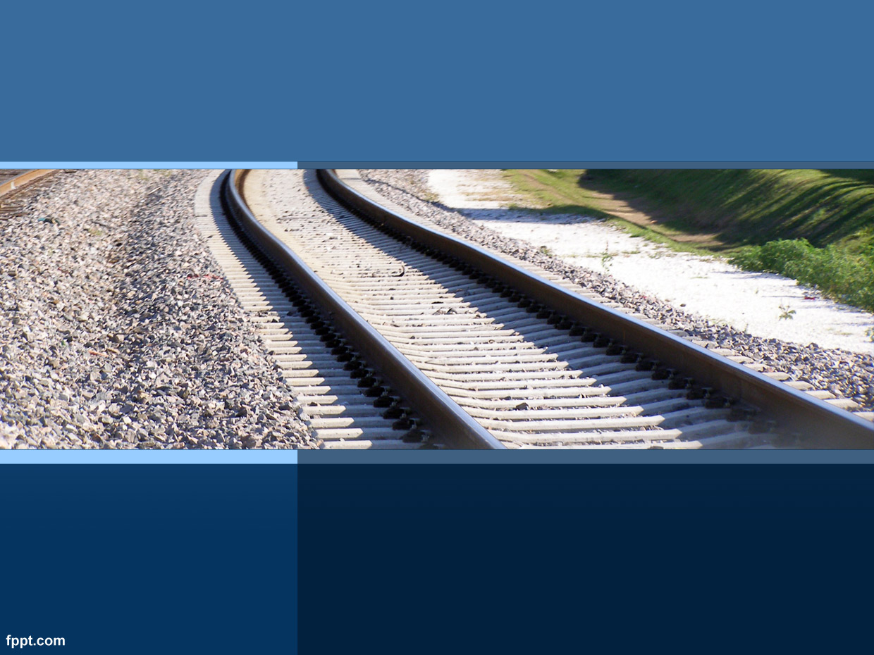
ITW PROJECT 2019
SwiftRail
Ashish Kumar (B. Tech - 18075068) Sachin Srivastava (B. Tech - 18075070) Manav Mukesh Jain (IDD - 18074021)

Slide 2
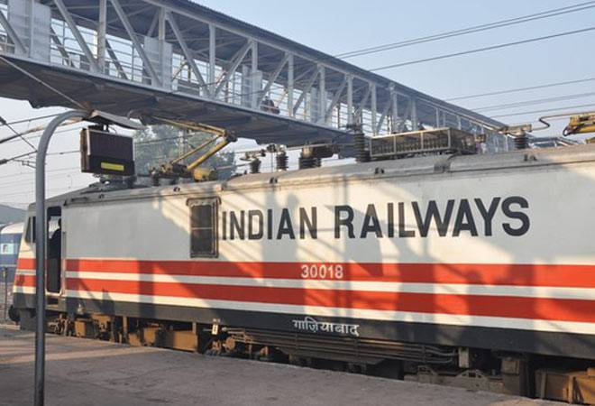
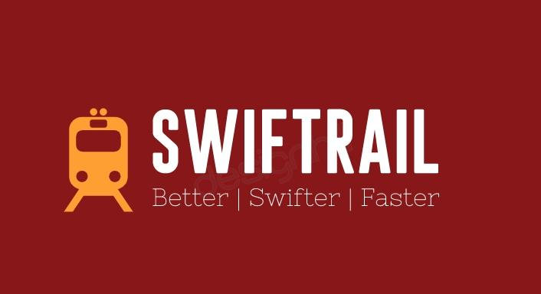
Why SwiftRail?
Indian Railway has 12,617 trains carrying over 23 million passengers daily
1.2 Lakh people can use its website at one time.
IRCTC booked 27 tickets when it was introduced in 2002. Now days IRCTC book average of 5 lakh tickets per day.
IRCTC provides various other services to its common masses via its efficient website.
To learn the functioning of such a website
To try and find out additional features.
To explore the creation of such a website.
To get a feel of the real time world and its requirements.
To learn how such complex operations of booking, cancelling, etc are done swiftly.

Slide 3
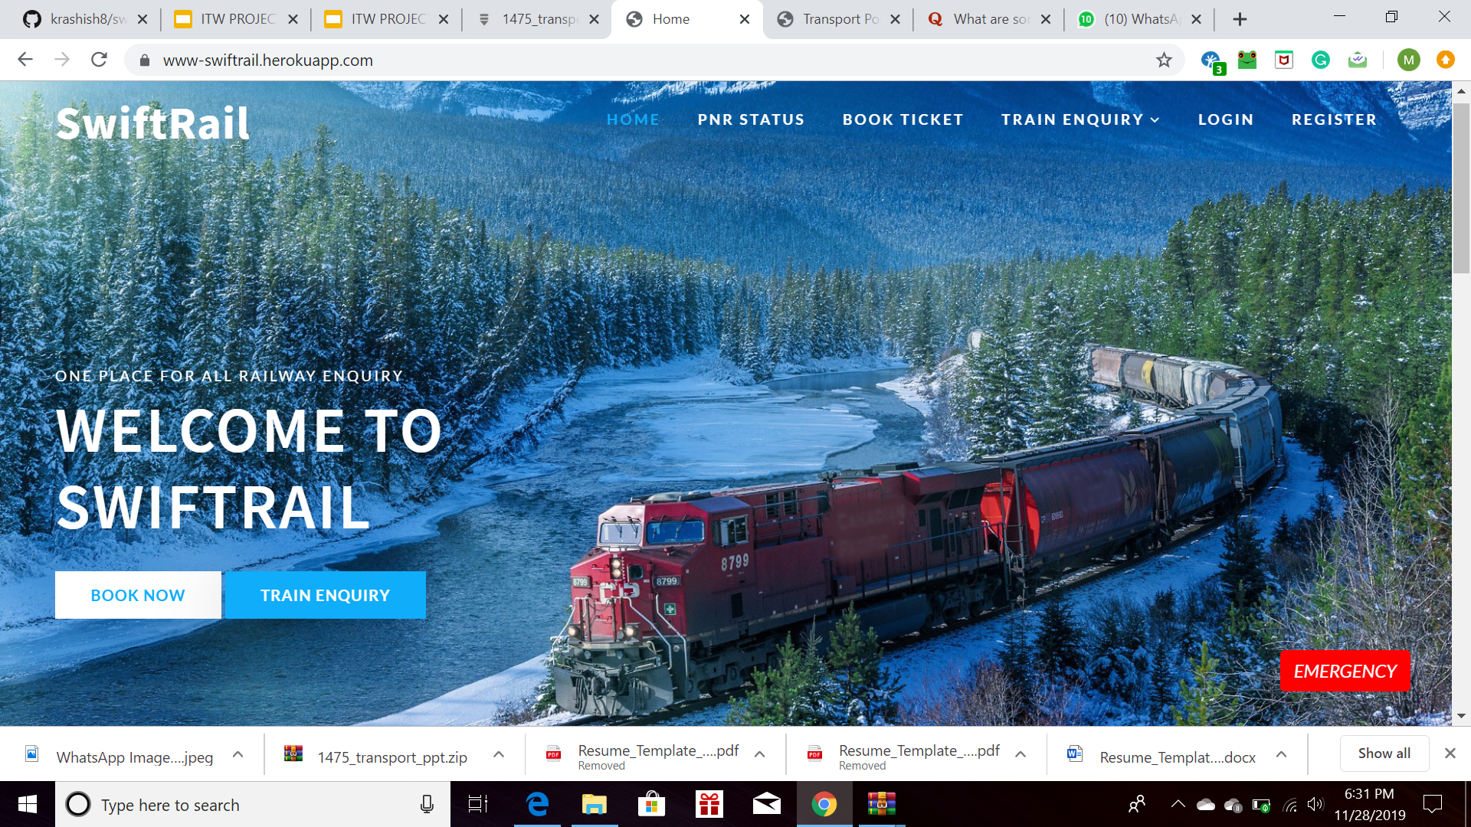
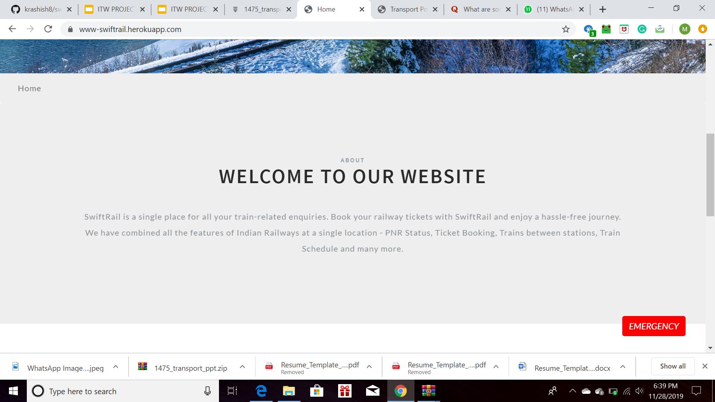
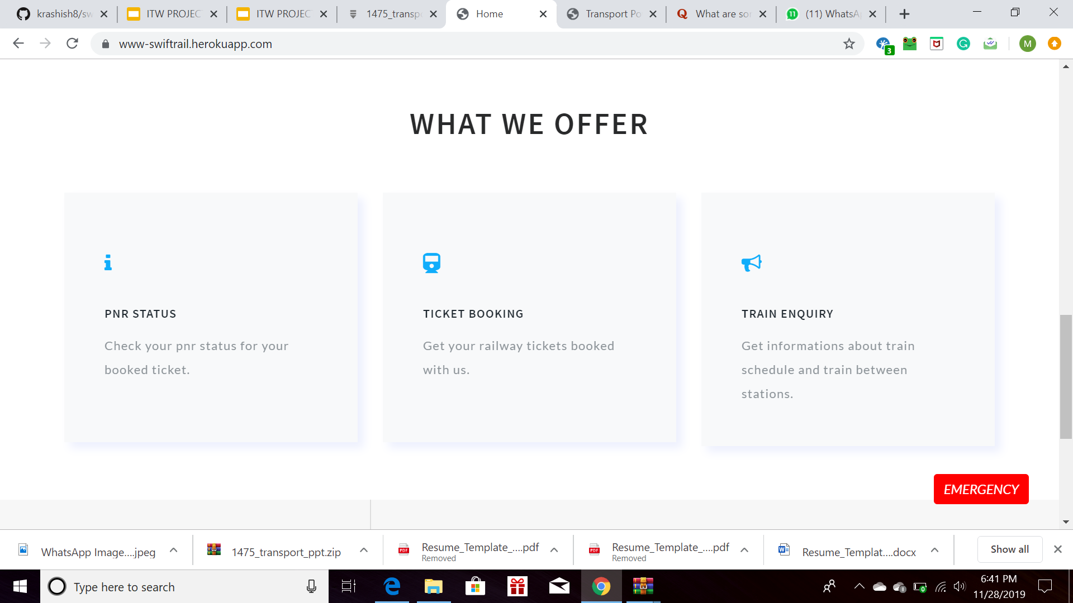
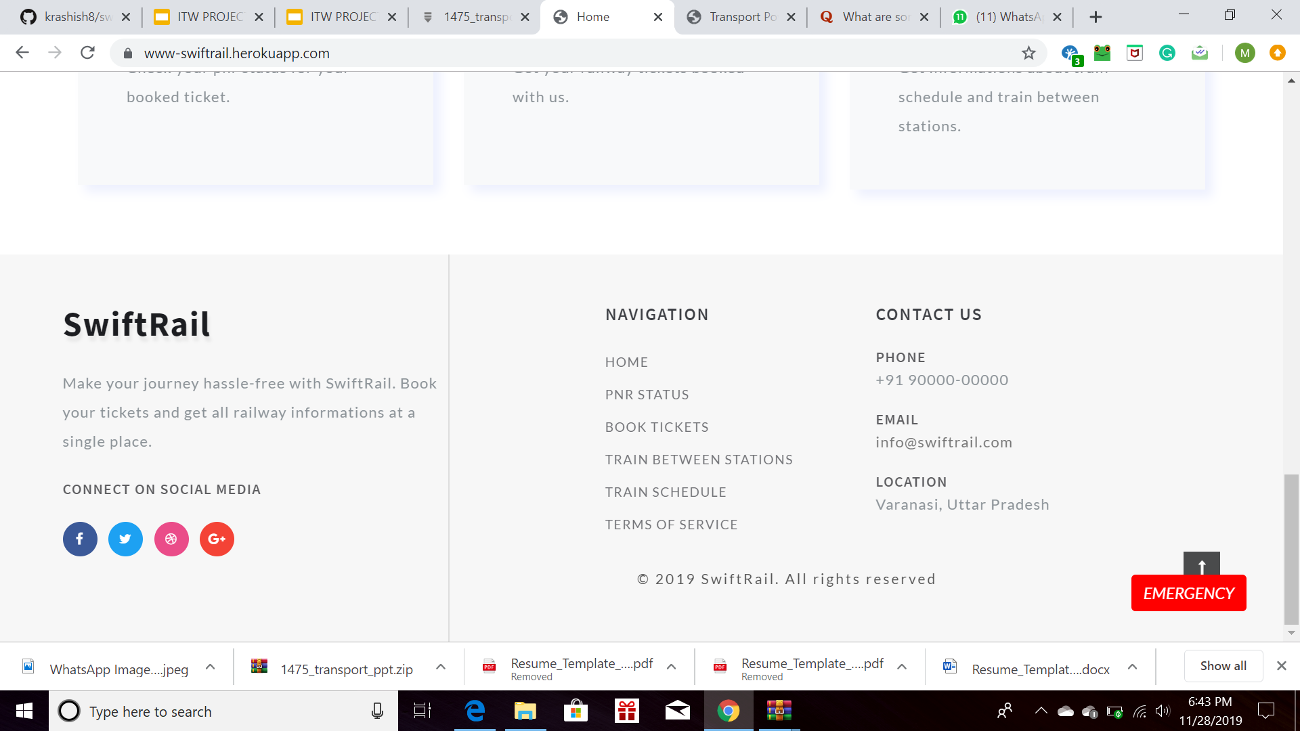
SWIFTRAIL WEBSITE
No. of Templates : 21 No. of models : 7 No. of stations : 100
No. of Pages : 21 No. of Services provided : 6 No. of trains : 10

Slide 4
WEBSITE HEADER
Contains a summary of all the tabs and services that are provided by the website.
It also has the Emergency button and the basic buttons to book ticket or enquire about trains
The next window is a welcome window which greets the user with a small message inviting them to use our website.

Slide 5
WEBSITE FOOTER
Contains a list of various options that SwiftRail provides. The contact us column gives information about the administrator of the website the website.
It also has the Emergency button.
The footer contains the list of social media websites where SwiftRail can be found.

Slide 6
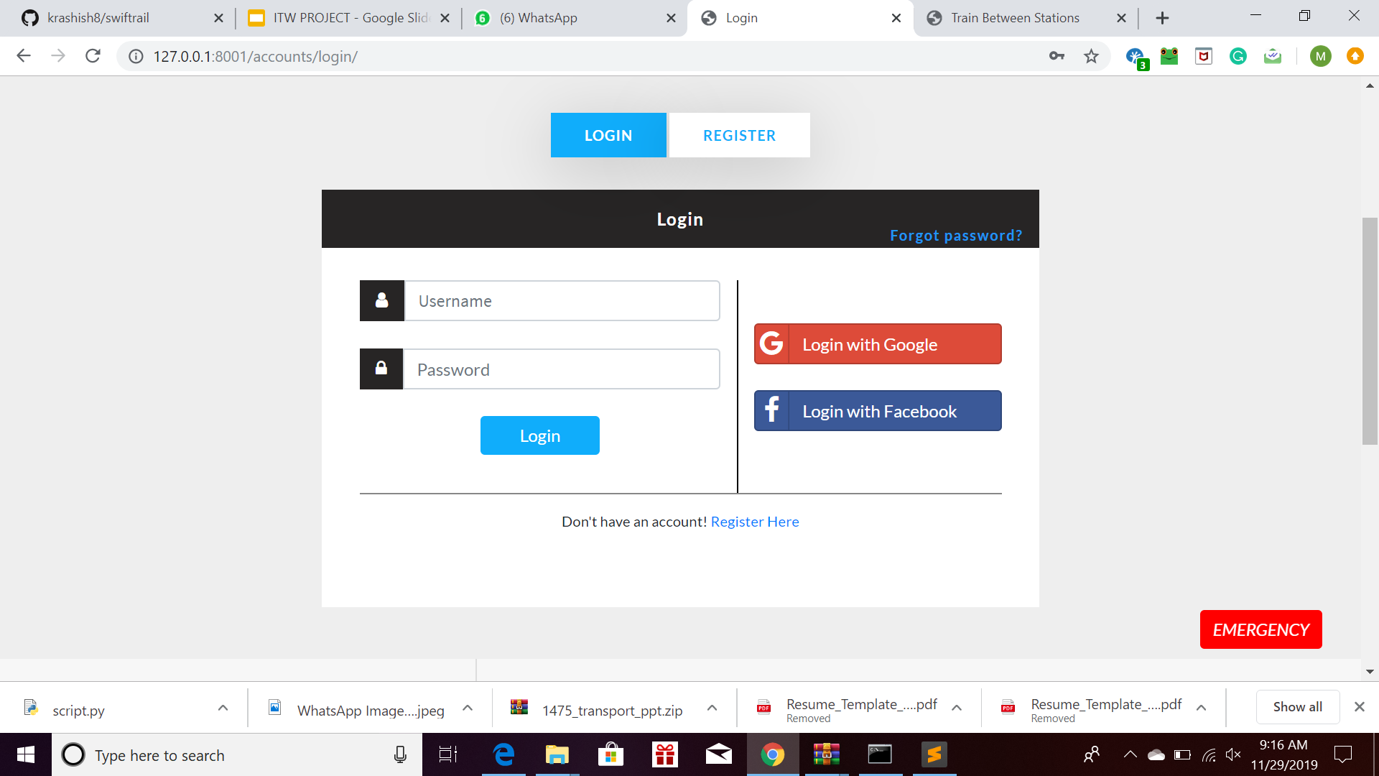
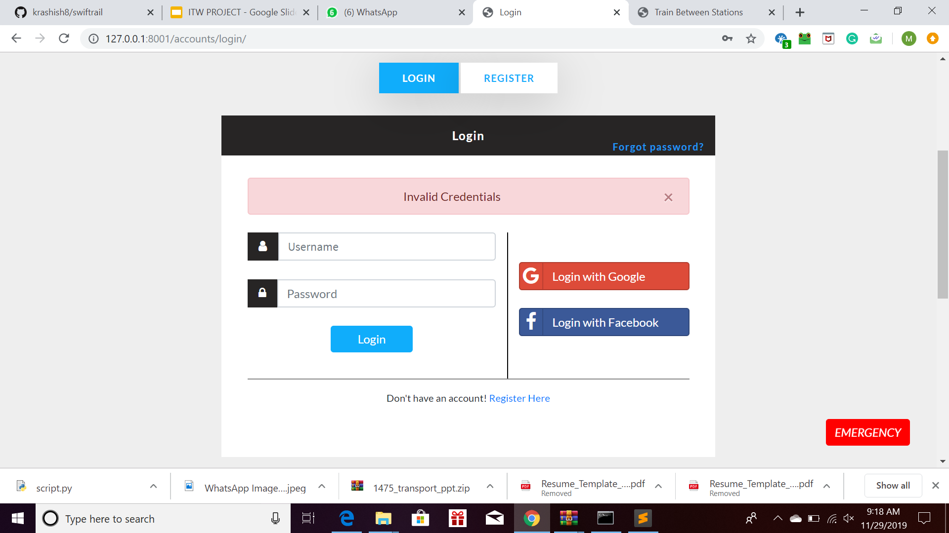
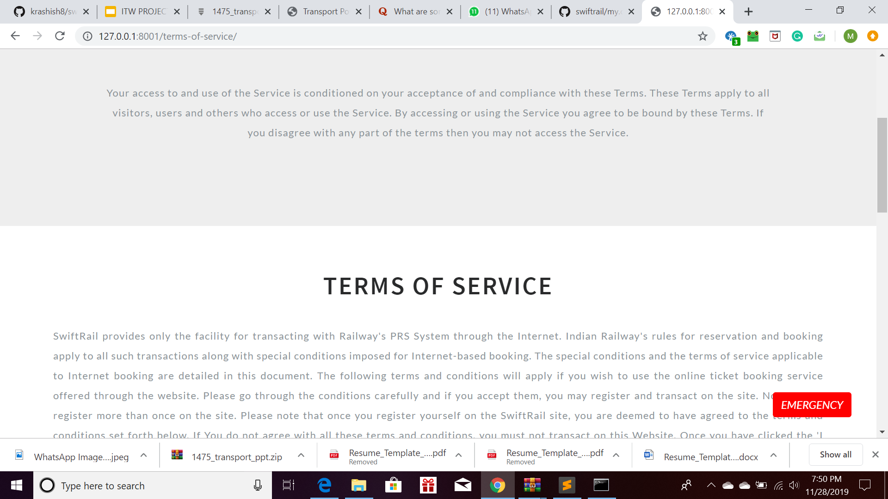
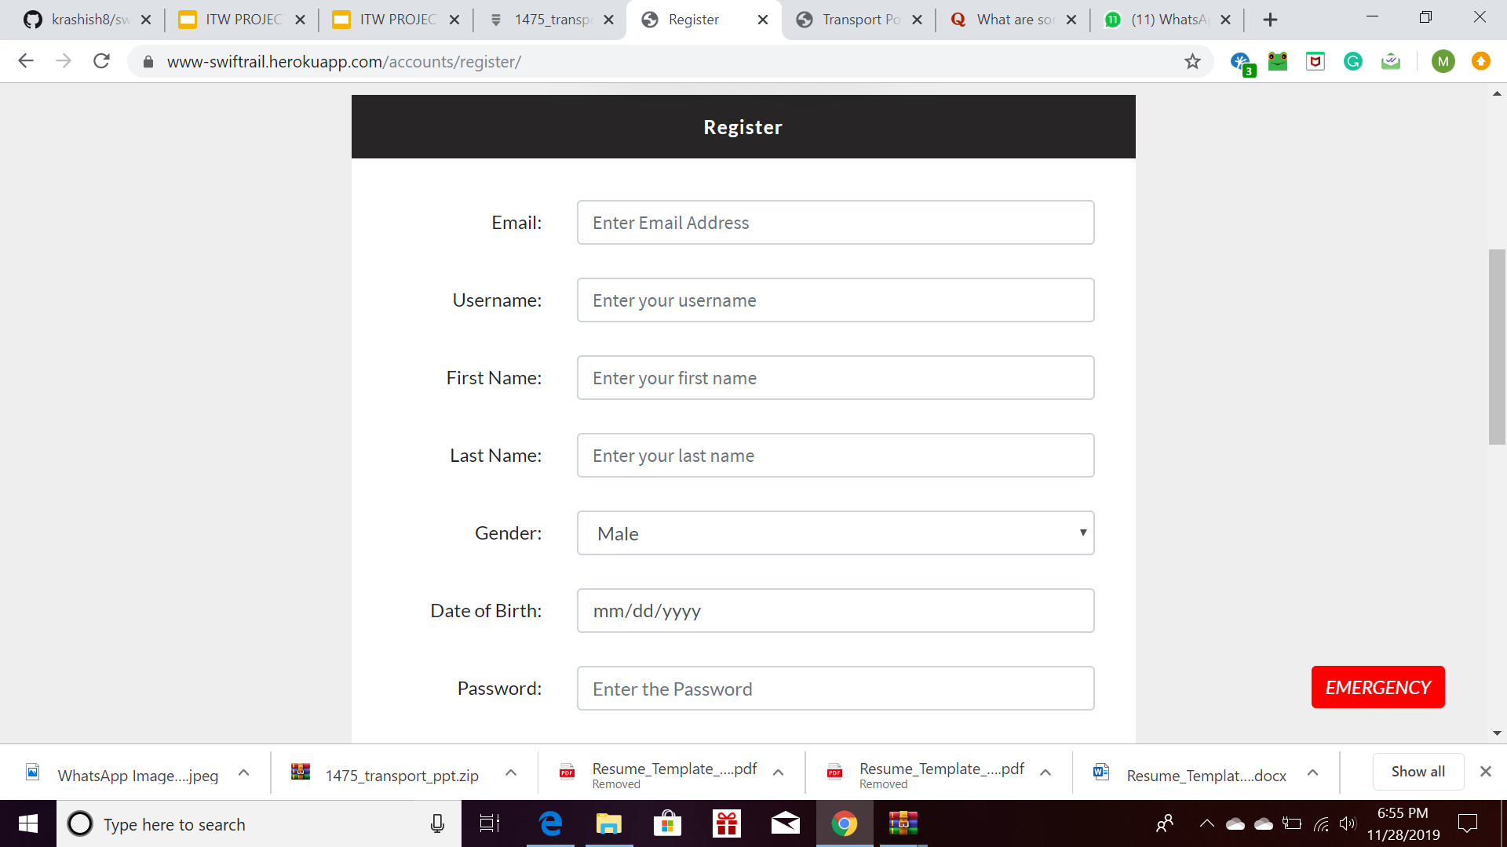
LOGIN and REGISTER
A user has to register and create his profile, after accepting the terms and conditions before using the website.
A user, if tries to use the website without logging in, is prompted to login first
In case fields are left empty, the user is scrolled up to the respective field with the password (min 6 char) erased.
A (green dot) in the top right indicates if a user has logged in or not alongside a new profile tab.

Slide 7
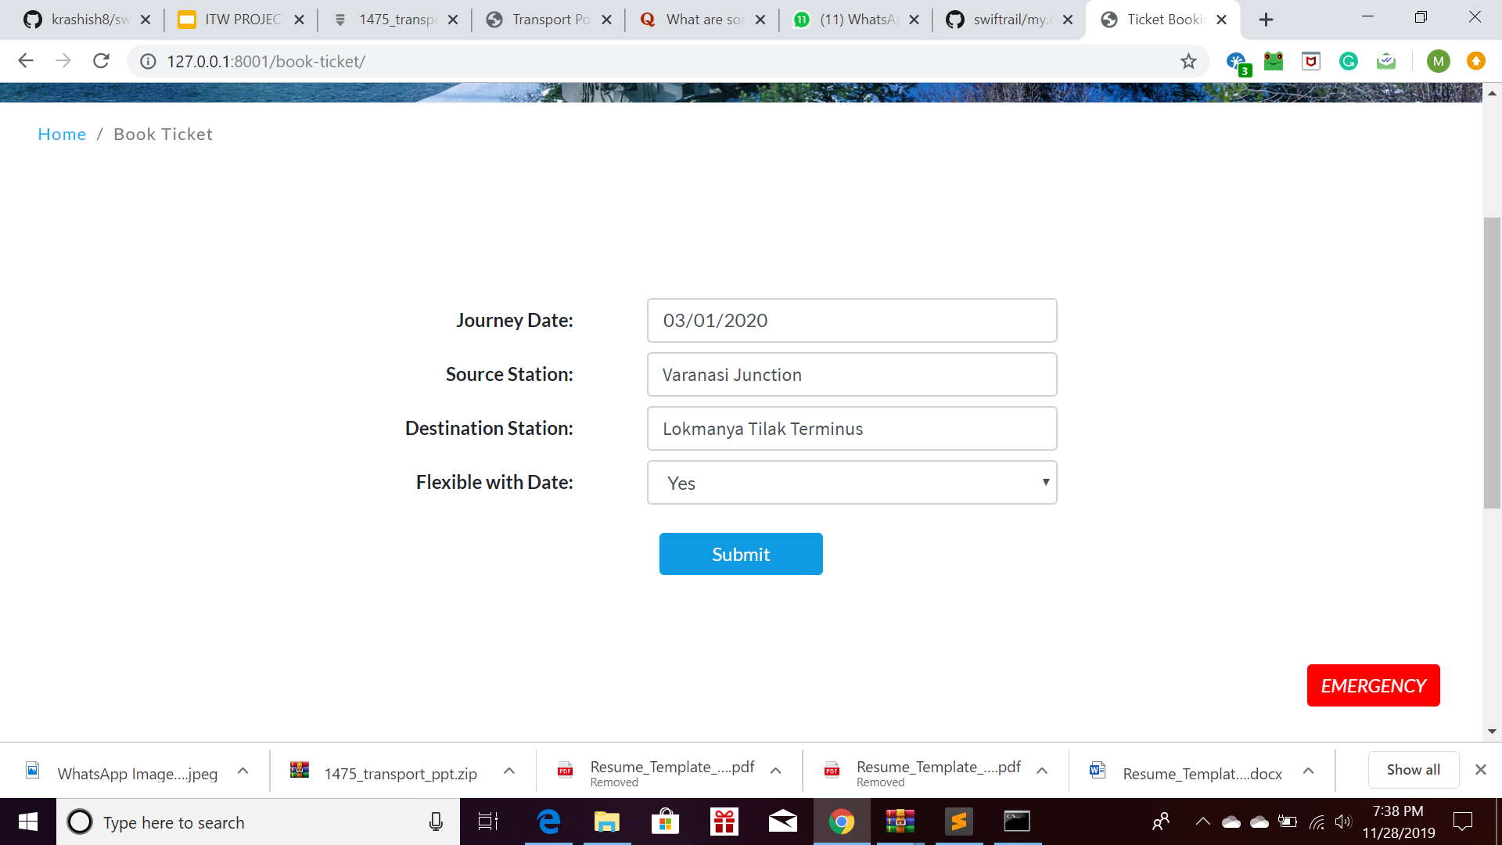
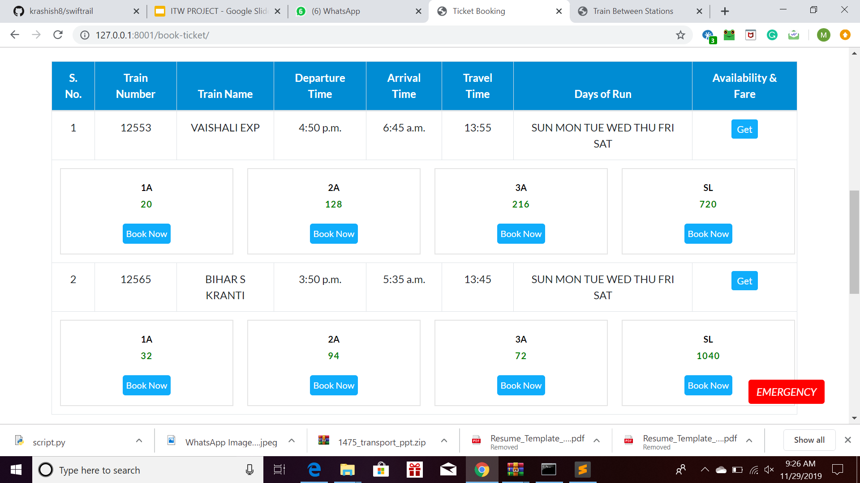
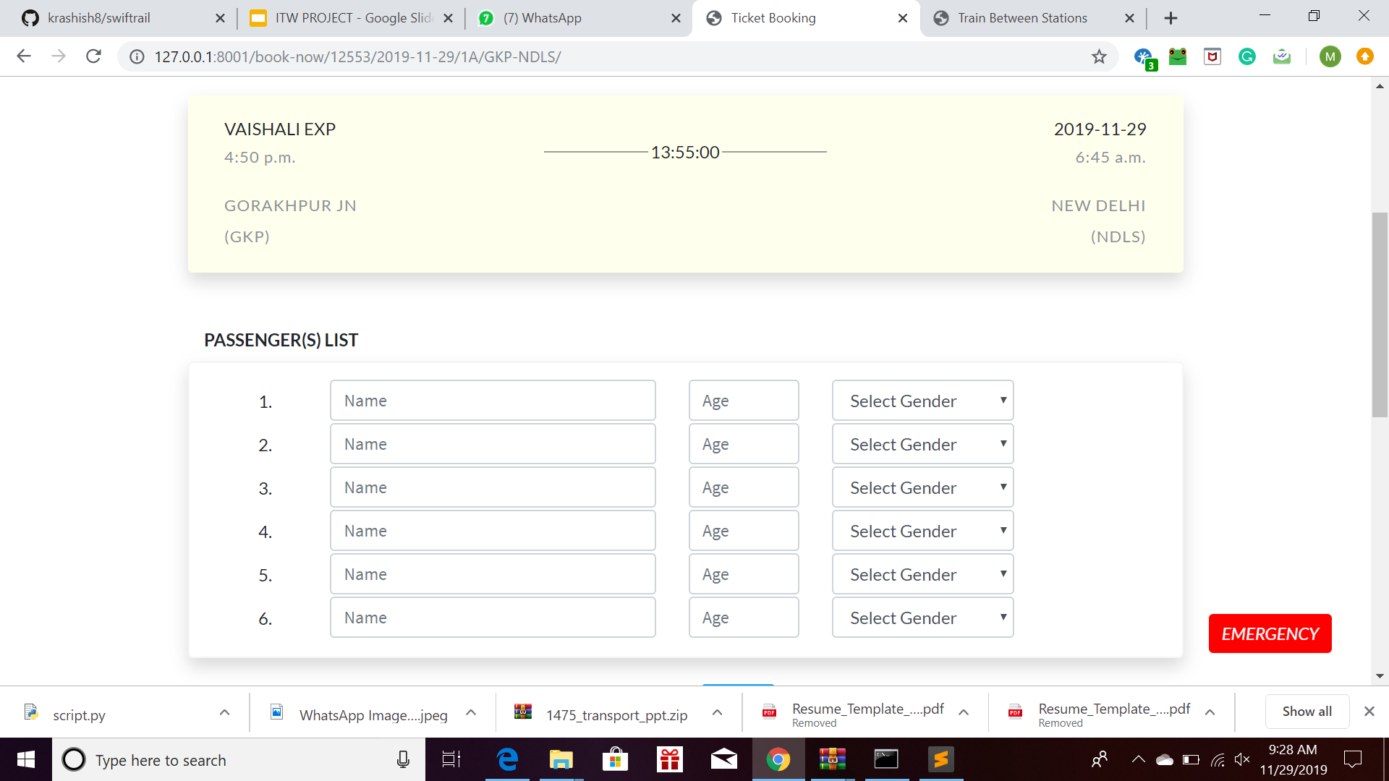
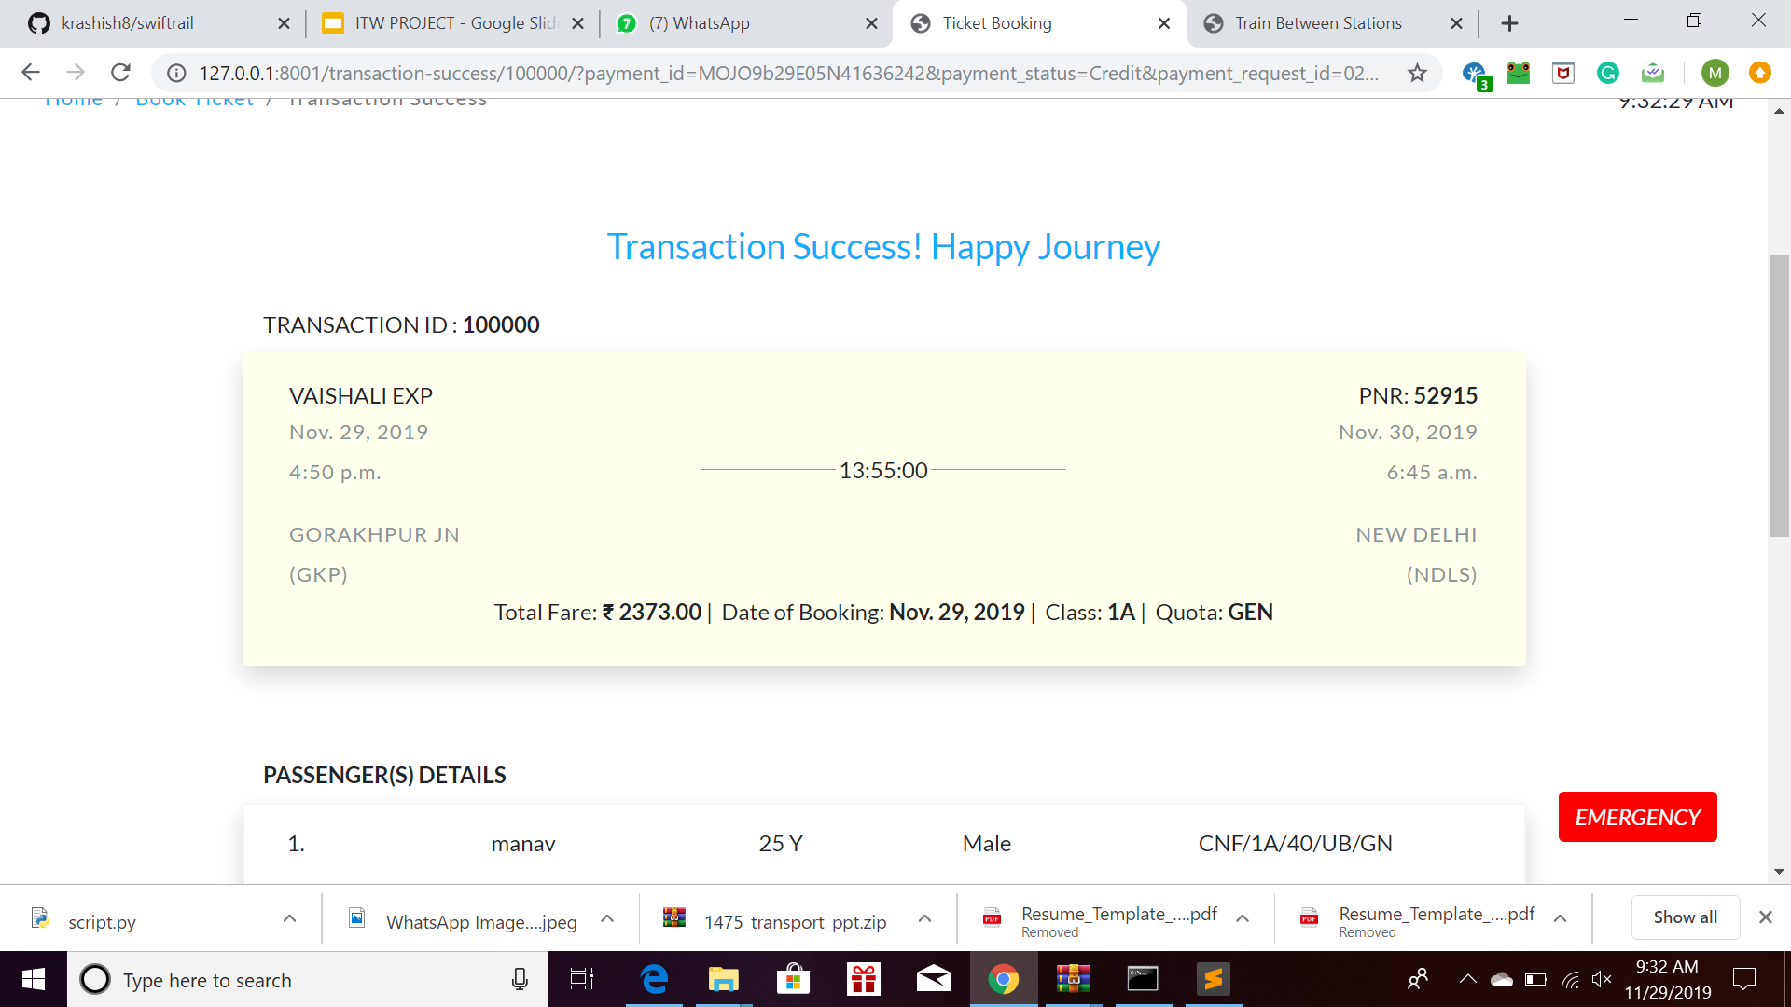
BOOK TICKET
Upon entering details, the list of trains is displayed, based on the source and destination
After finding an appropriate train, the user moves to the payment portal.
The PNR Status of a user can be checked wherein, based on the PNR Number, the query works.

Slide 8
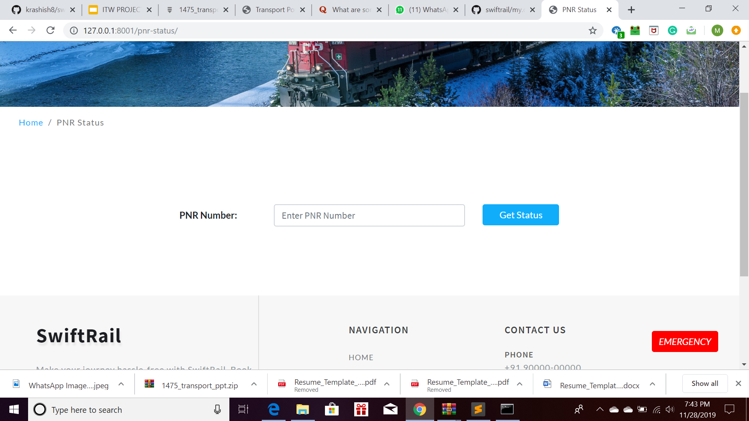
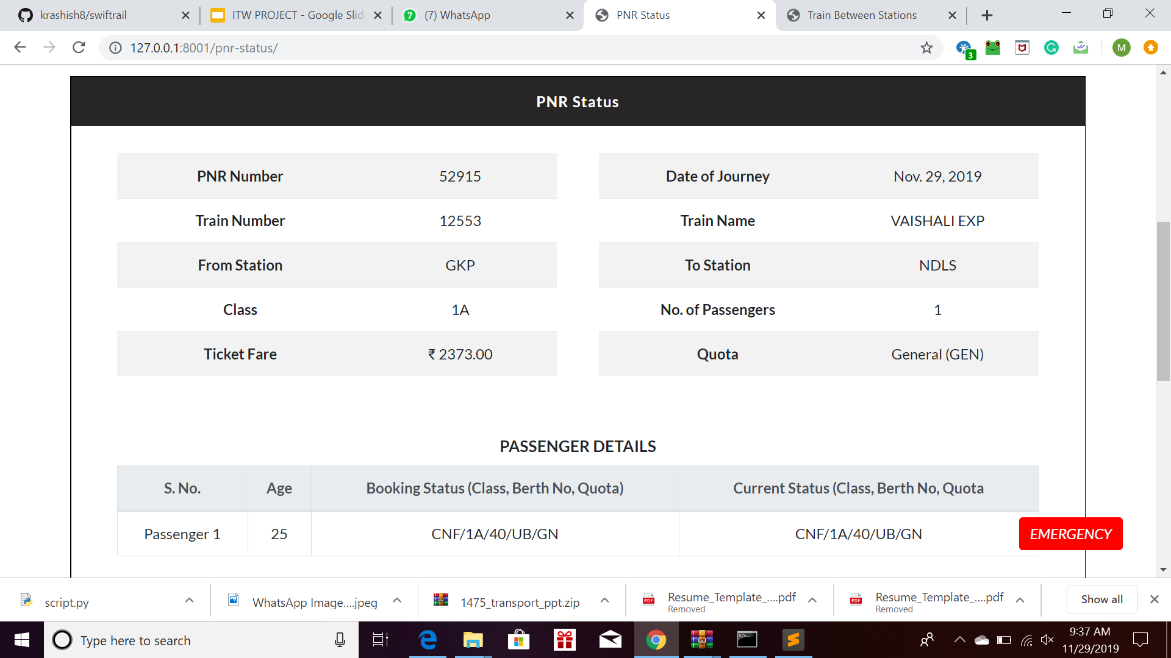
PNR ENQUIRY
PNR Enquiry allows user to enter the unique PNR Number of their transaction.
The PNR Number is mentioned on the top right corner of the booked ticket.
The PNR Status displays the fields as given in the image. The PNR Status also includes the details of the passenger alongwith the details of their ticket booking.
This is one of the newest features on various railway websites.

Slide 9
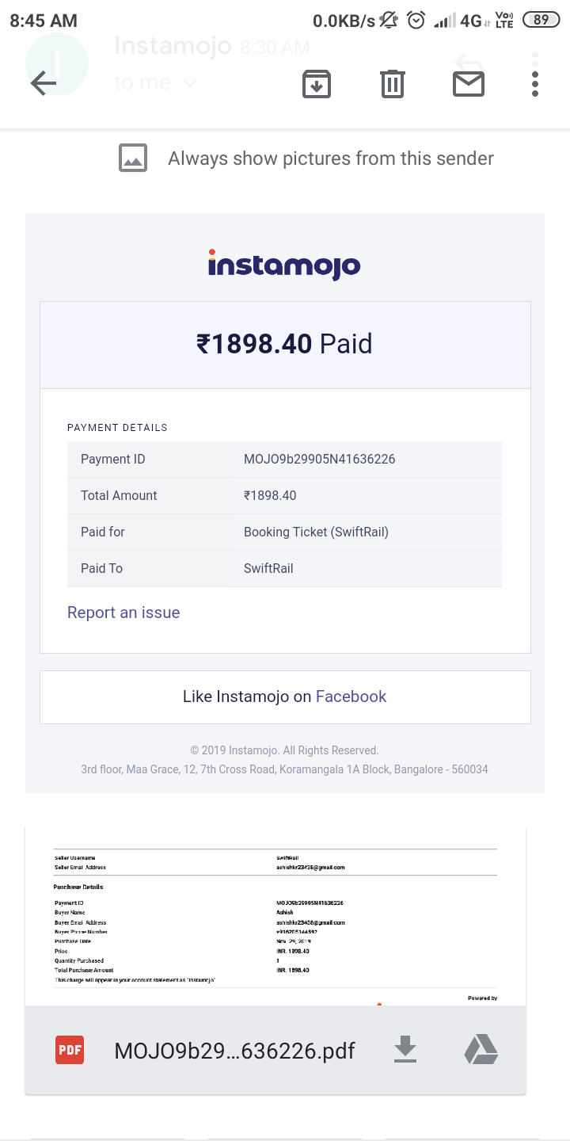
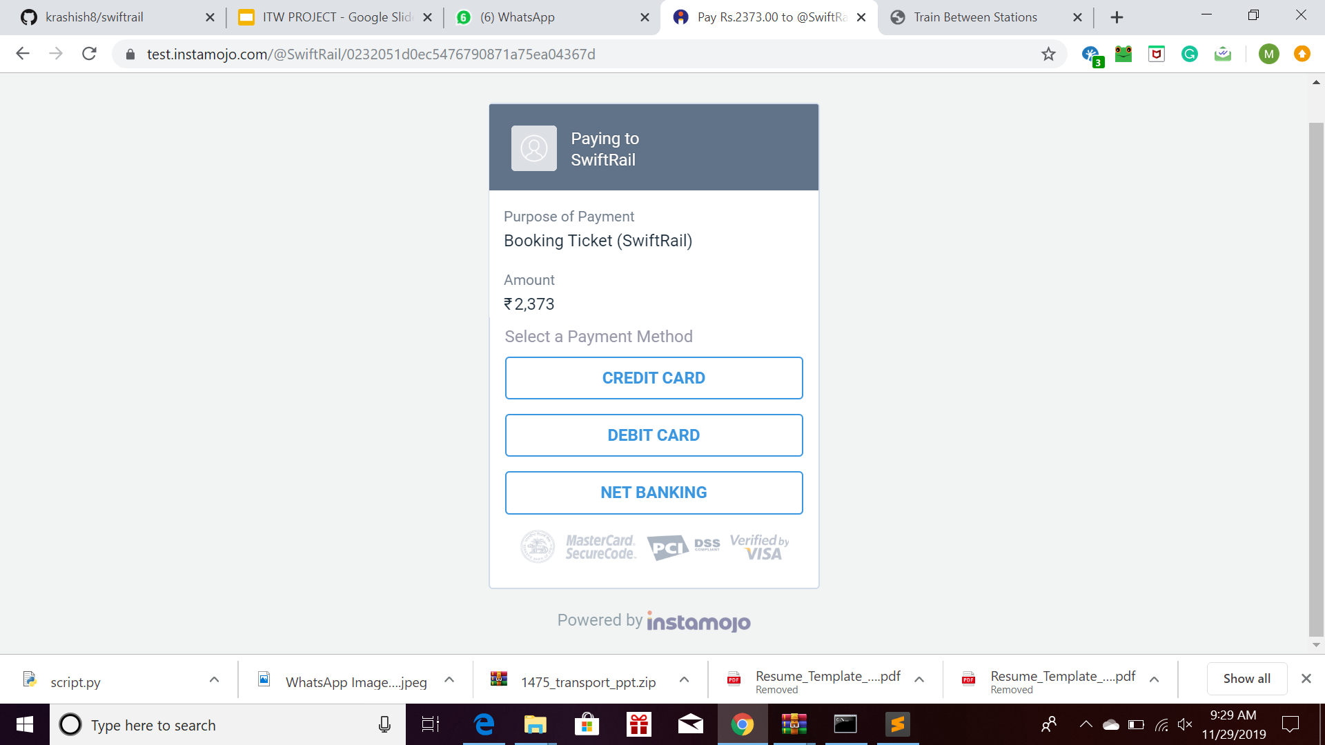
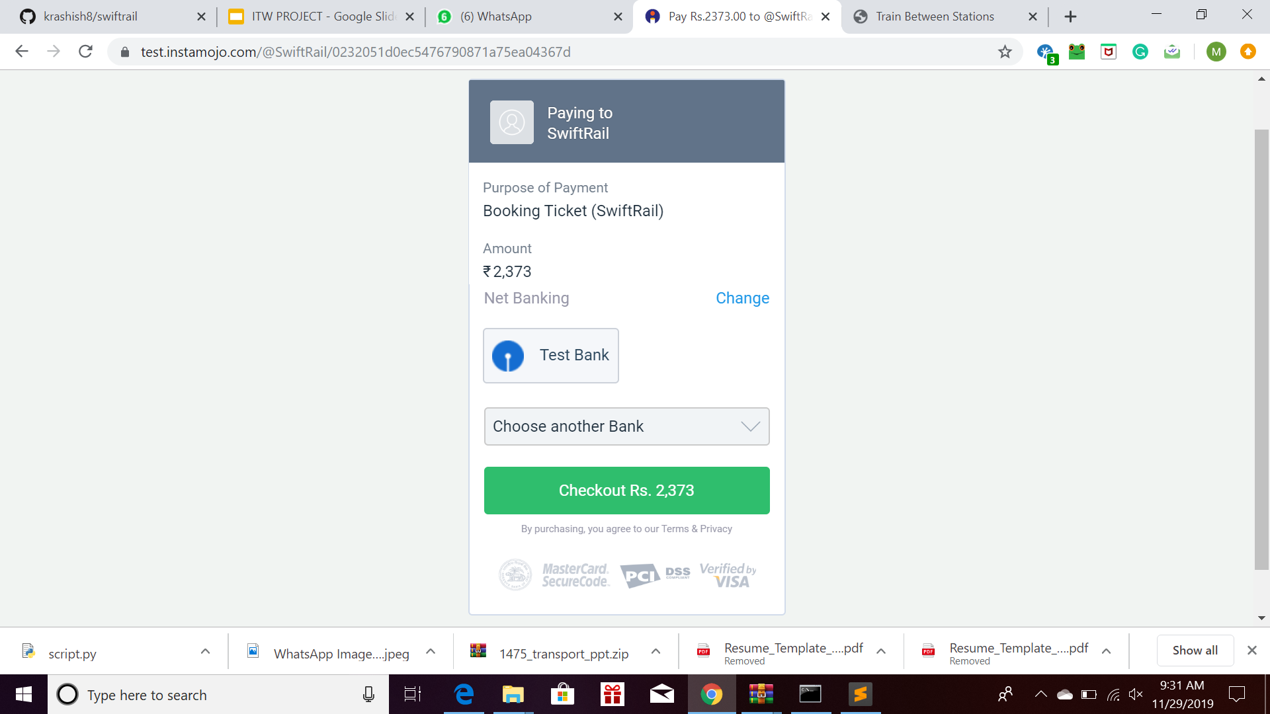
PAYMENT PORTAL
The payment portal allows user to make payments online for booking ticket.
The user is given a transaction ID for every transaction made.
The user gets a confirmation mail about ticket booking and payment.

Slide 10
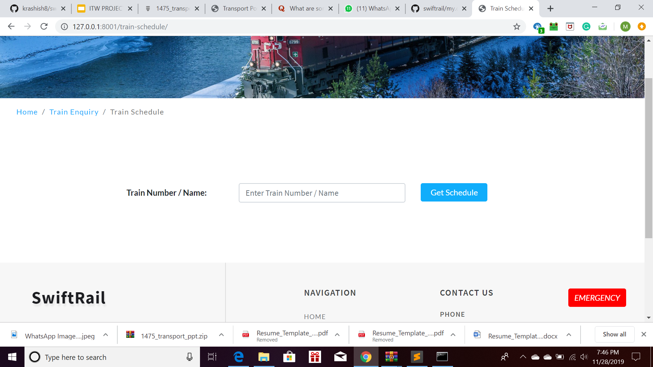
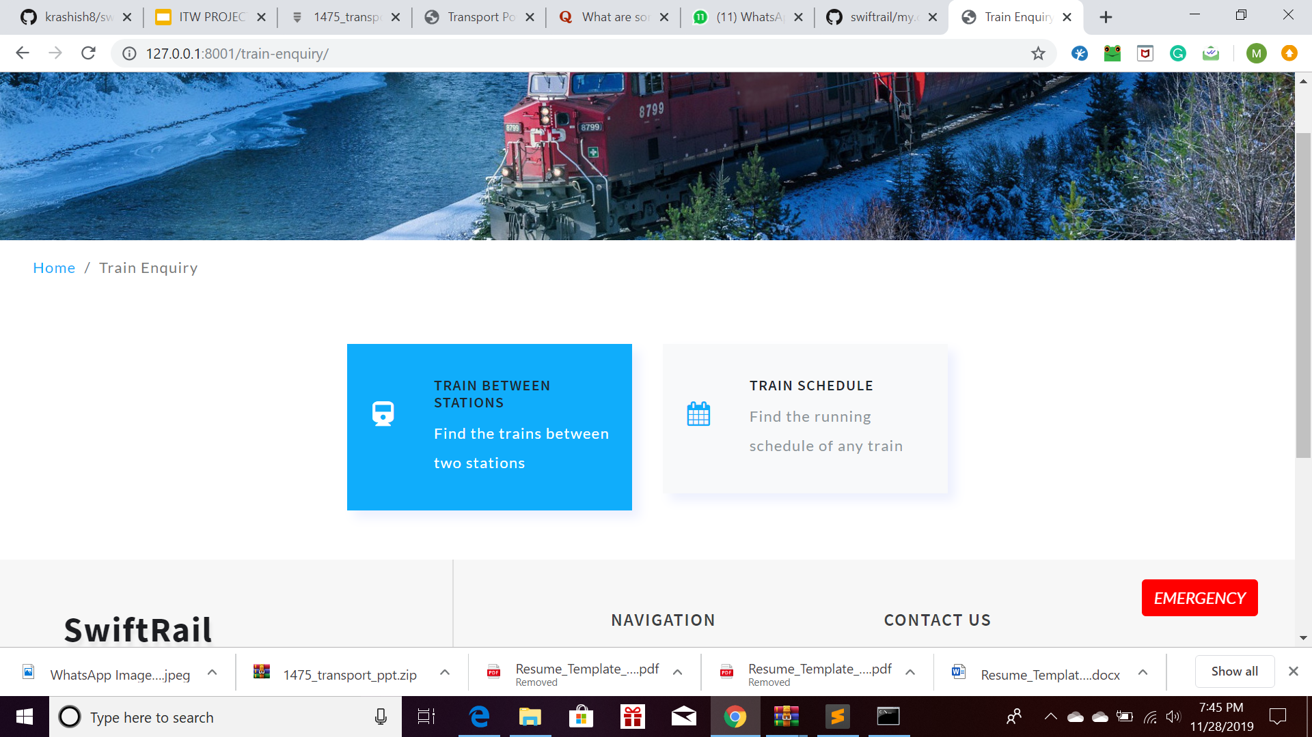
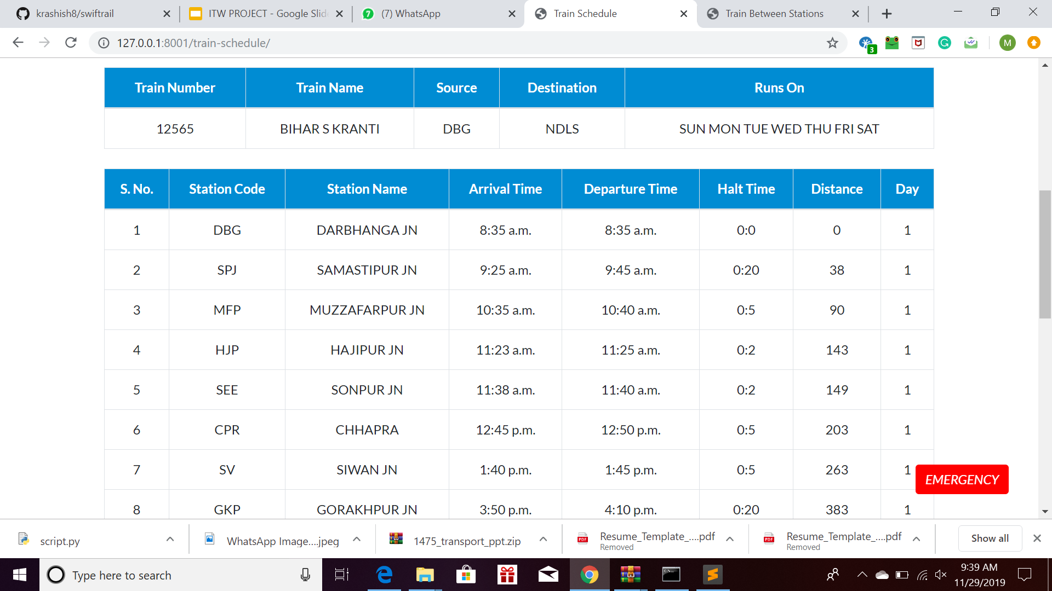
TRAIN SCHEDULE
The Train enquiry tab provides two options : Train between Stations and Train Schedule.
The Train Schedule page allows the user to enter the number of the Train to be searched
The output page gives a detailed schedule of the train number specified for the user’s perusal.

Slide 11
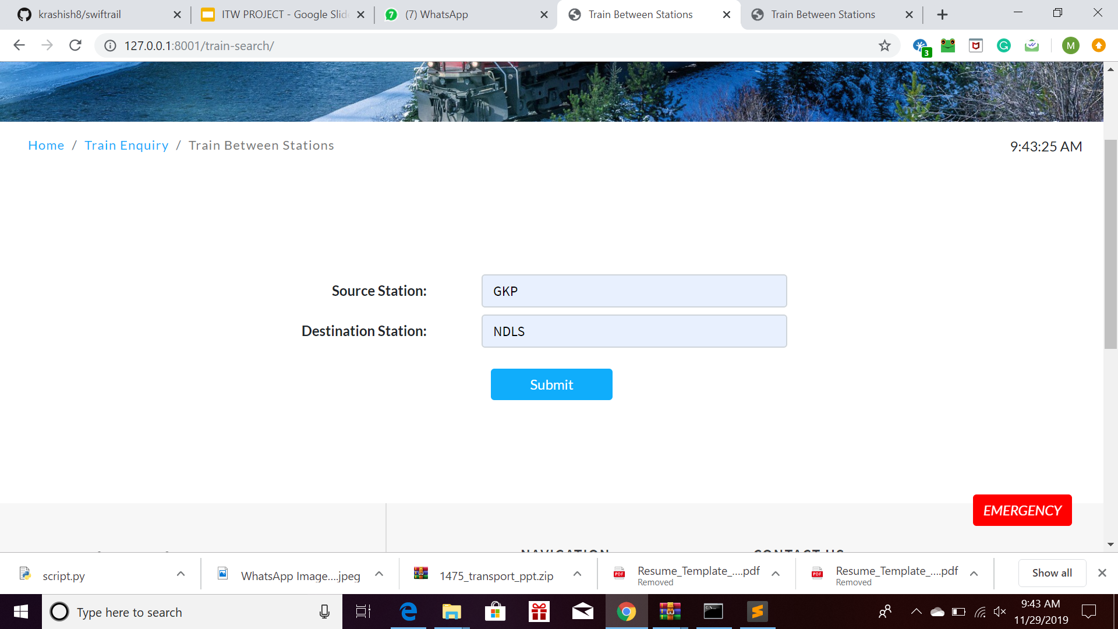
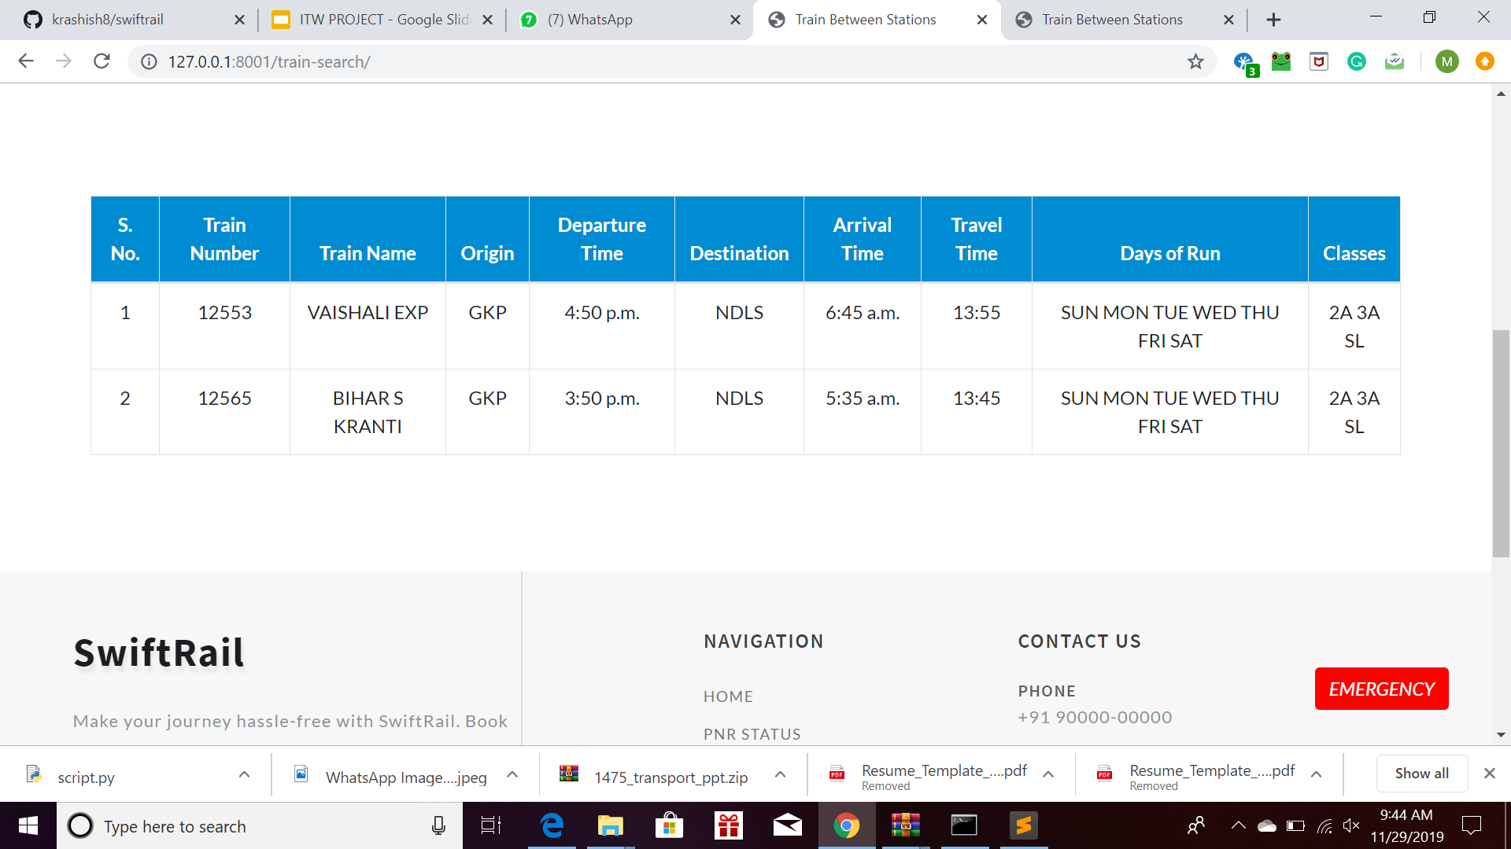
TRAIN BETWEEN 2 STATIONS
This page is the second part of Train enquiry. It asks the user for two fields : The Source and the Destination of their journey.
Based on the data entered, the display page gives a list of all trains that run between those two stations.
The train details include the queries as shown in the image.

Slide 12
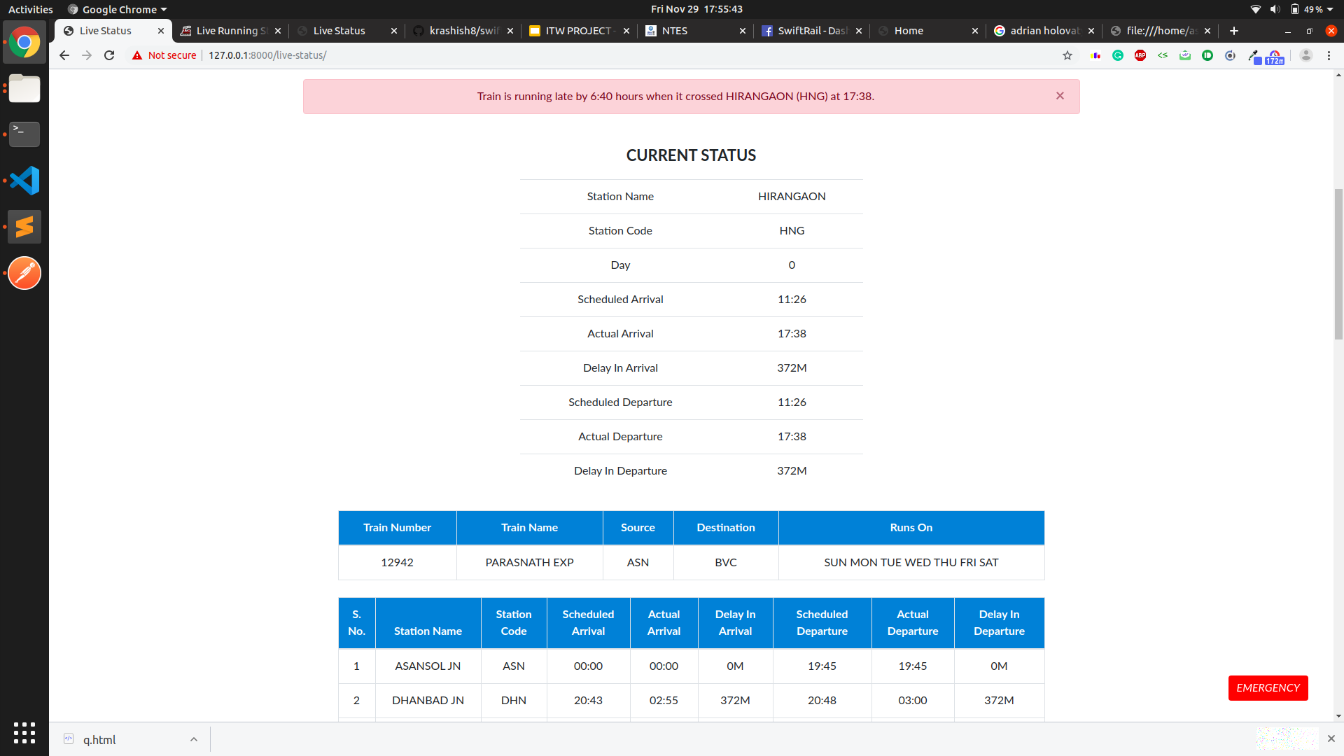
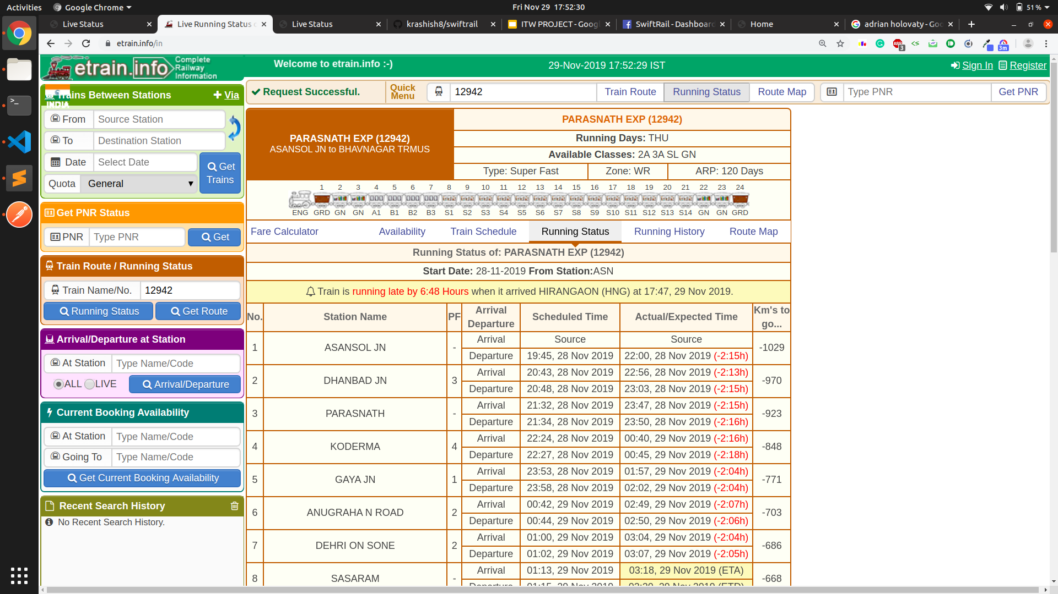
LIVE RUNNING STATUS
The Live Running Status allows the user to search a train.
Based on the data entered, the display page gives the live running status of the train.
The Real-time status has been confirmed with SwiftRail’s status.

Slide 13
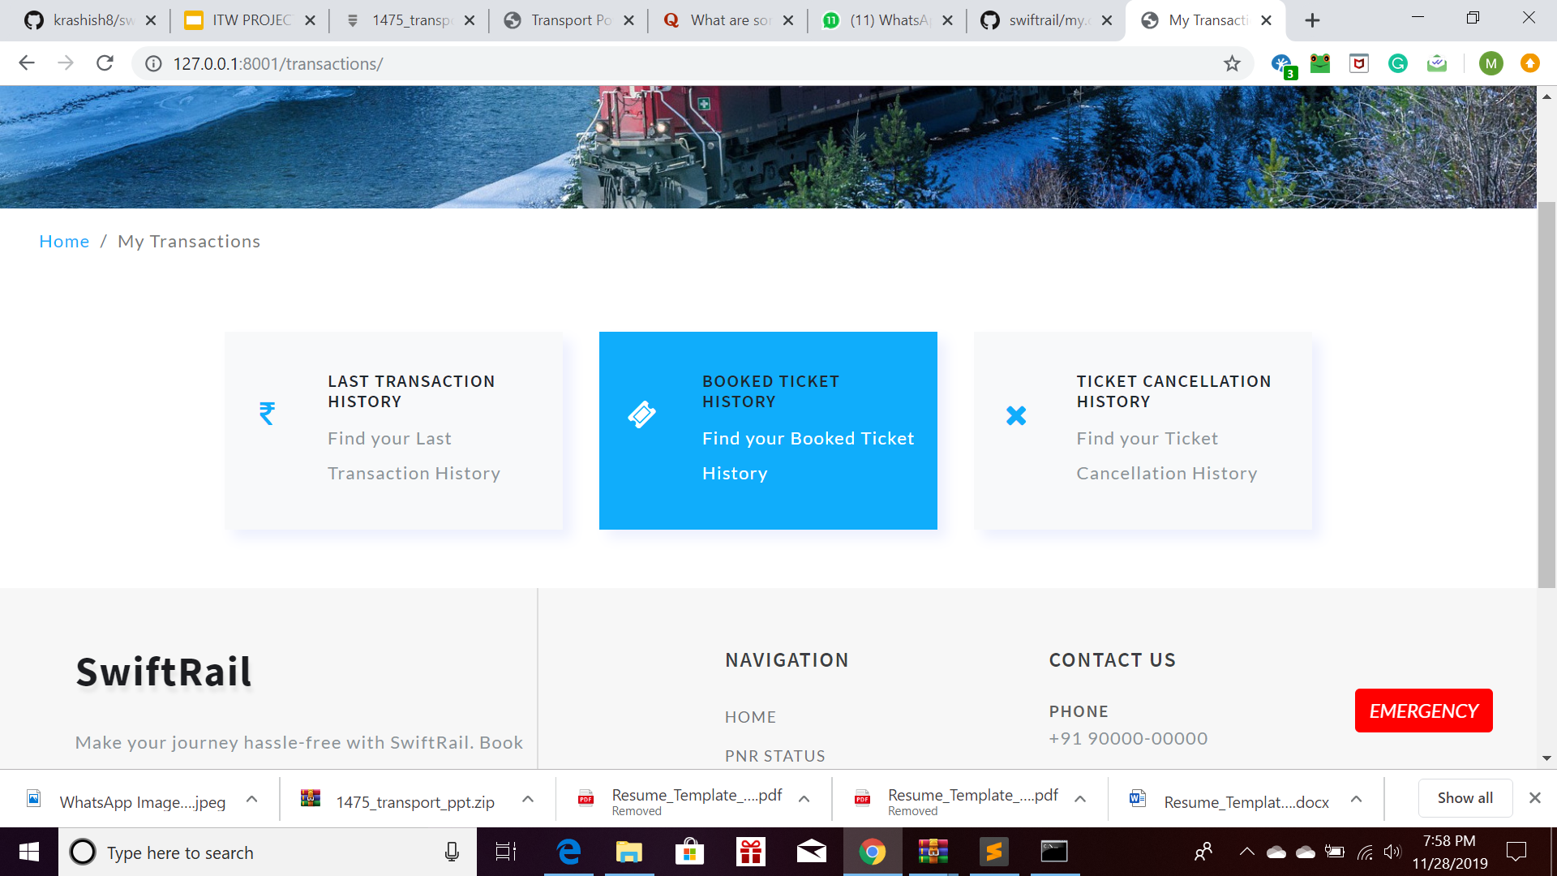
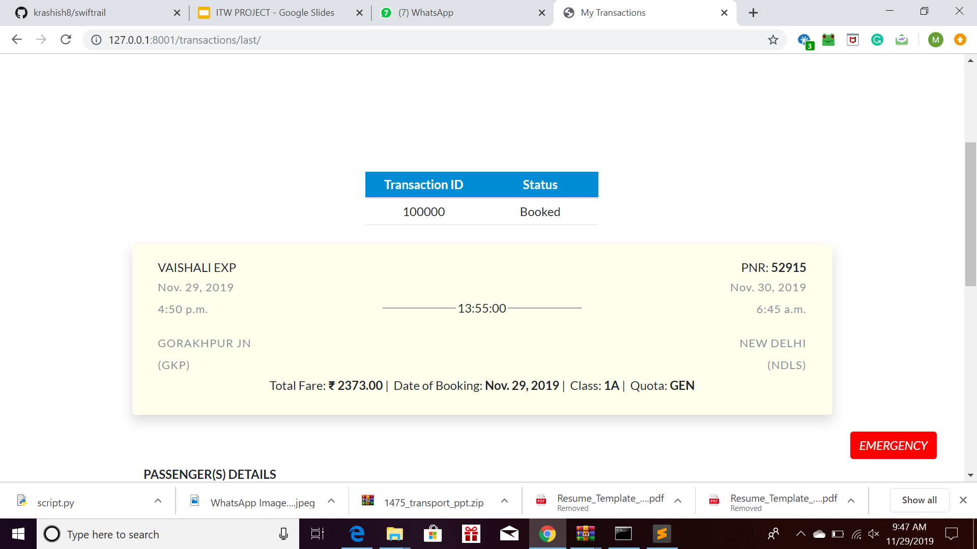
LAST TRANSACTION HISTORY
These three fields summarise all the booking transactions of the user. In the database, maintained as separate fields, they are interconnected using foreign keys This tab is to help the user keep record as well as for proof of transaction.
The My Transactions tab has drop-down menus if hovered over on the home page and gives separate clicking buttons in the center when clicked separately.

Slide 14
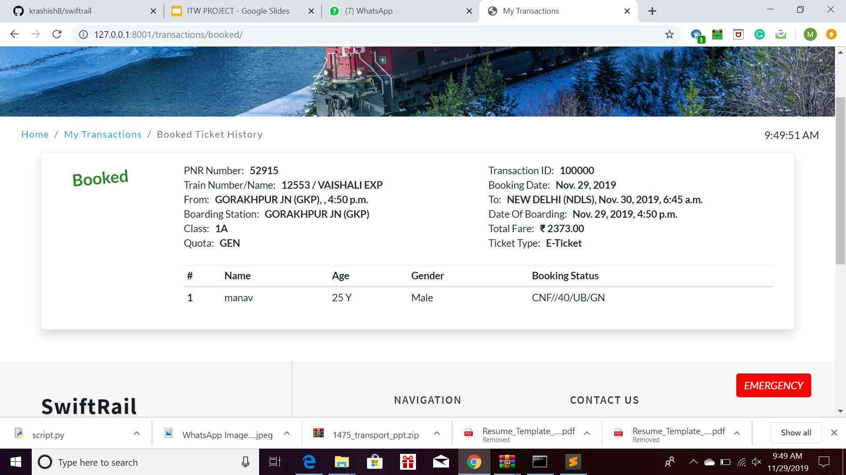
BOOKED TICKET HISTORY
These three fields summarise all the booking transactions of the user. In the database, maintained as separate fields.
This tab is to help the user keep record of the tickets they had booked
The My Transactions tab has drop-down menus if hovered over on the home page and gives separate clicking buttons in the center when clicked separately.

Slide 15
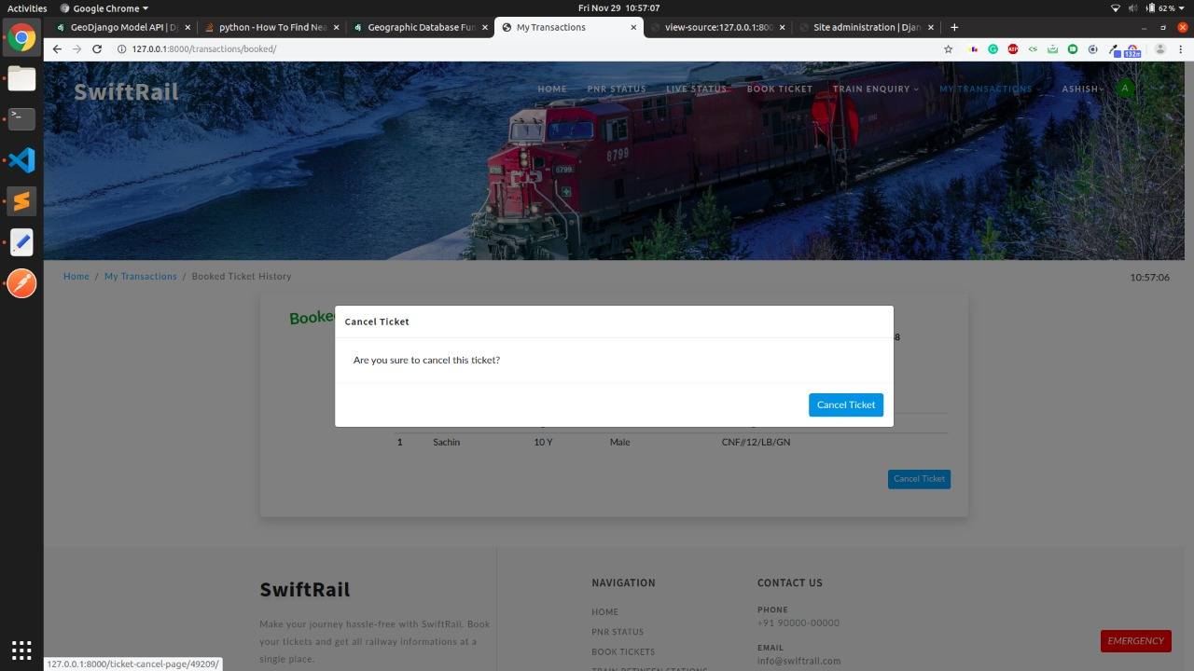
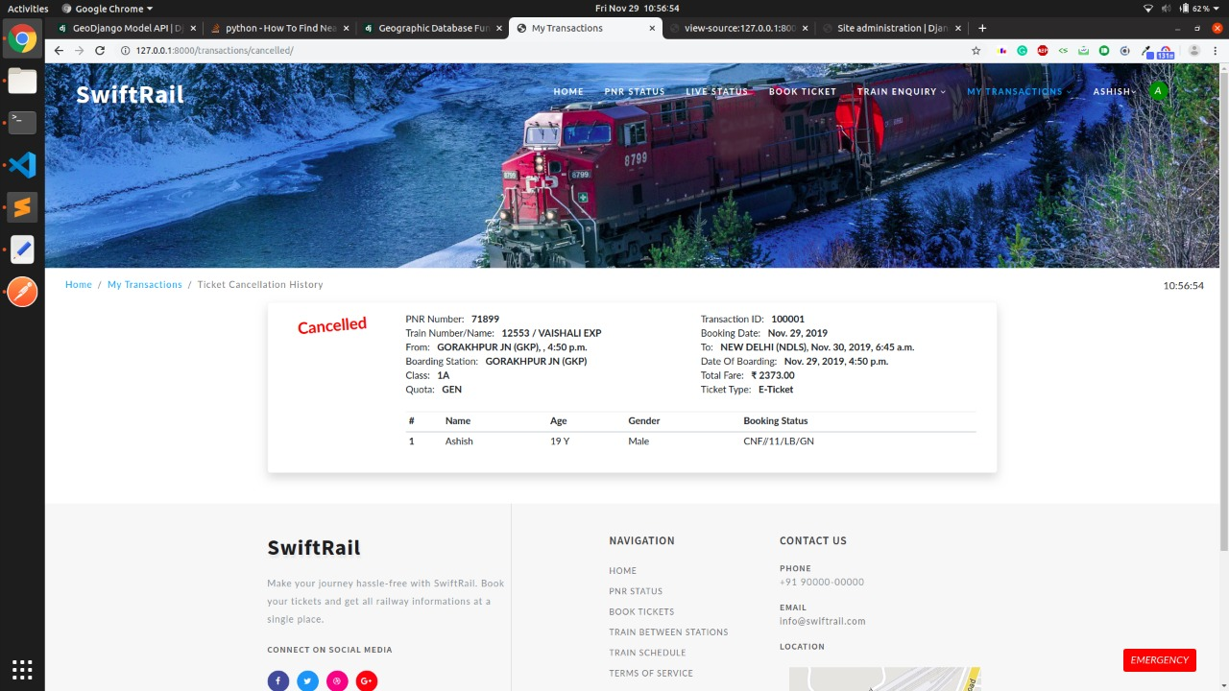
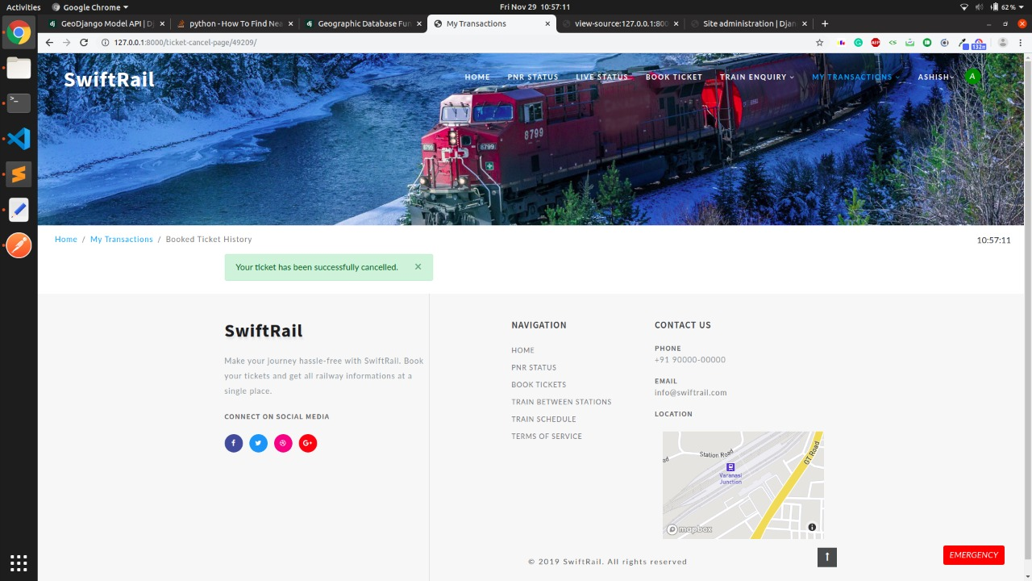
TICKET CANCEL HISTORY
The Cancel ticket option gives a prompt to the user whether they really want to cancel it.
When cancelled, a message is displayed to confirm the cancellation.
The Cancellation is reflected in the Last Transaction Detail.

Slide 16
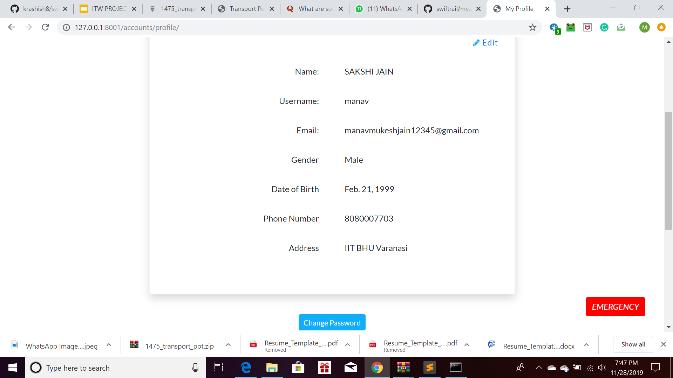
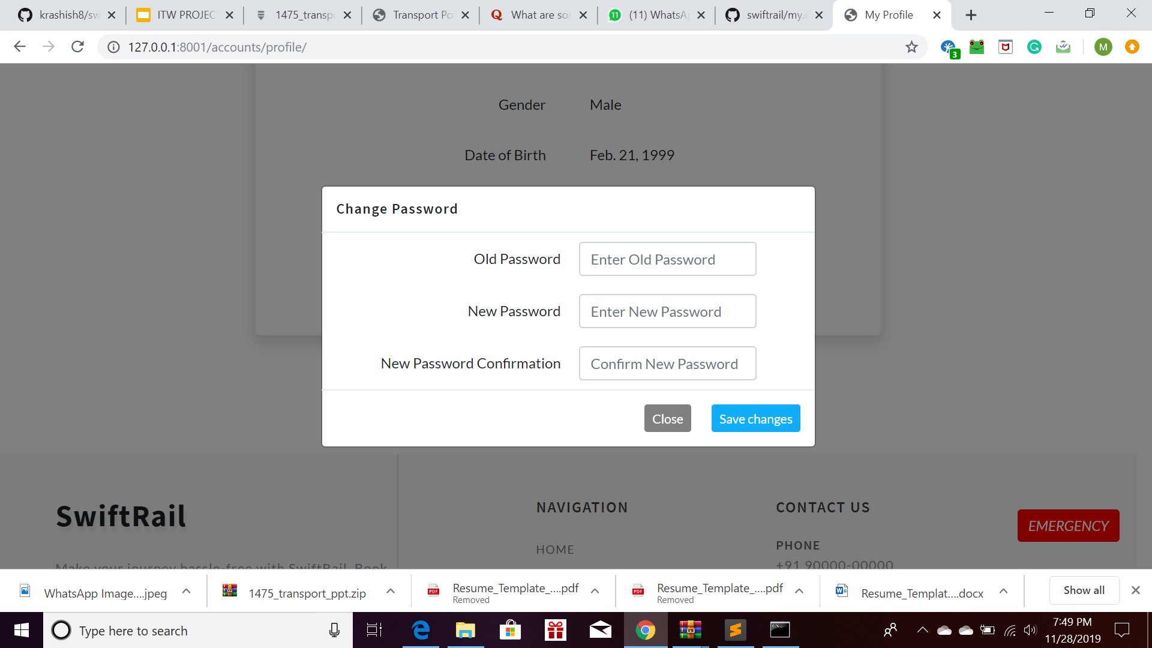
MY PROFILE
The My Profile Tab, when clicked displays a list of user data that was input during registration.
A user is allowed to change their password through this. The Change Password dialog box appears when this button is clicked.

Slide 17
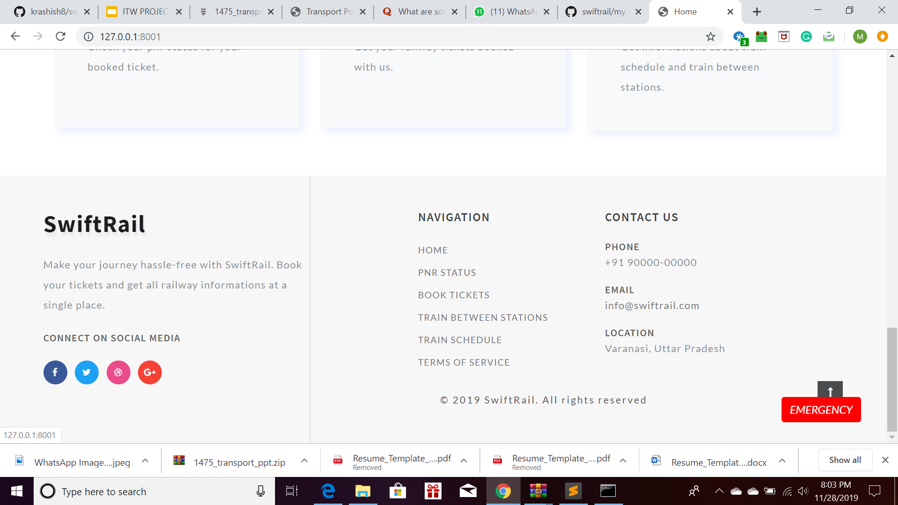
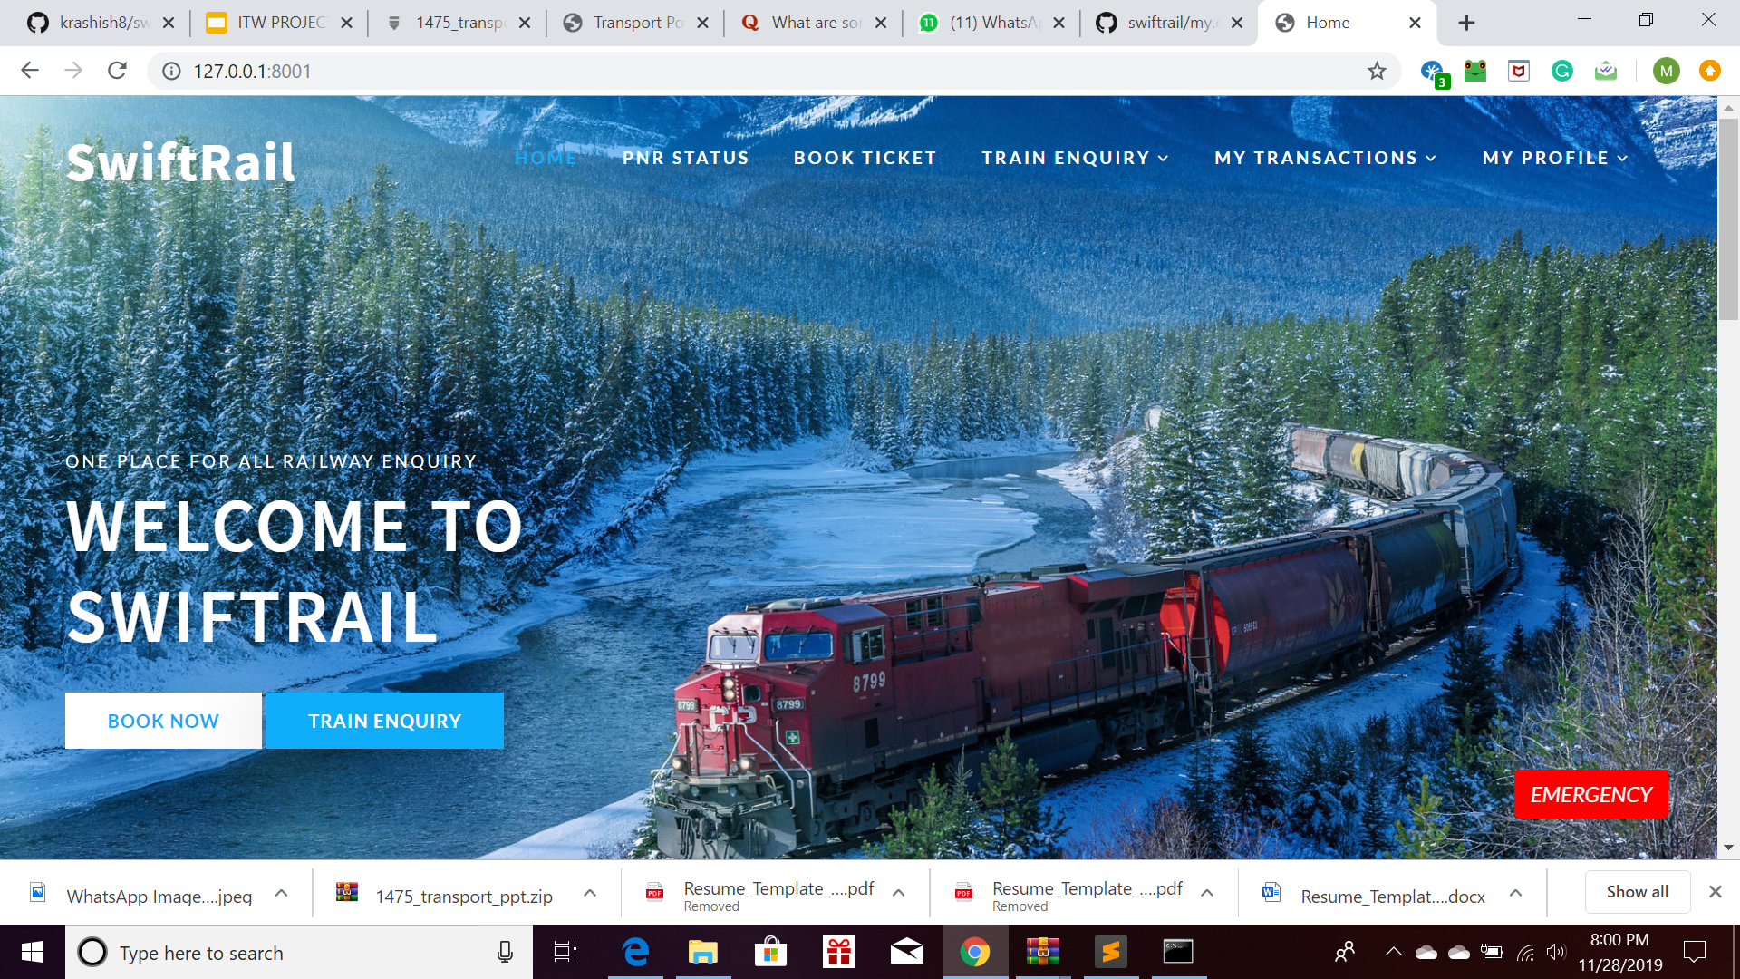
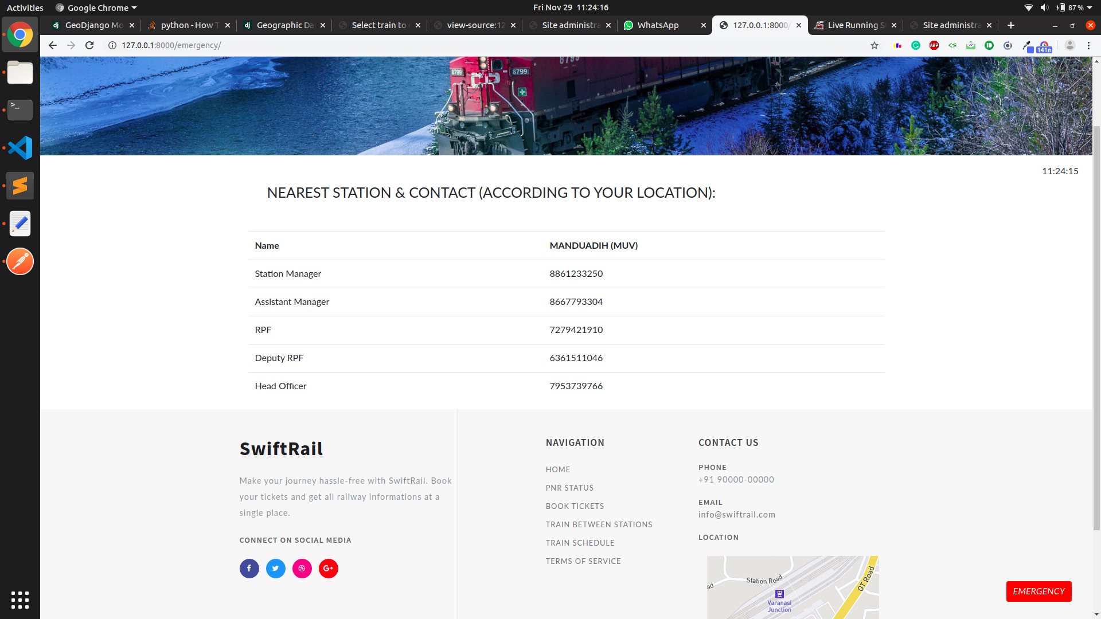
OTHER FEATURES
The Emergency button is a static button which is maintained throughout all the pages of the website. When clicked, it shows a list of nearby officials of nearest stations.
The Terms of Service list the privacy policy and terms of use of the website. A user must go through before proceeding with the transaction and registration process.
The logos of various social media website allows user to connect to SwiftRail on these platforms.

Slide 18
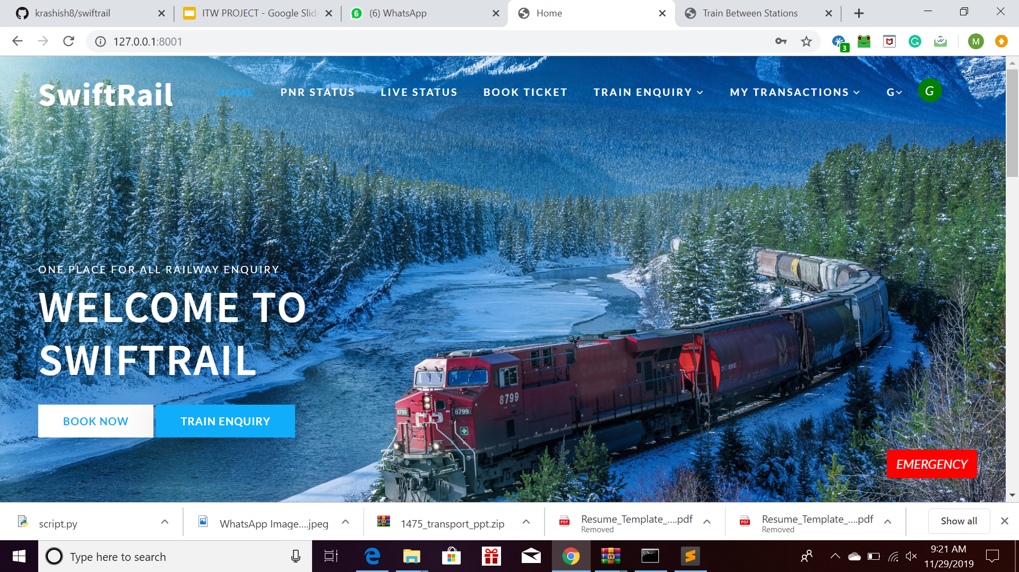
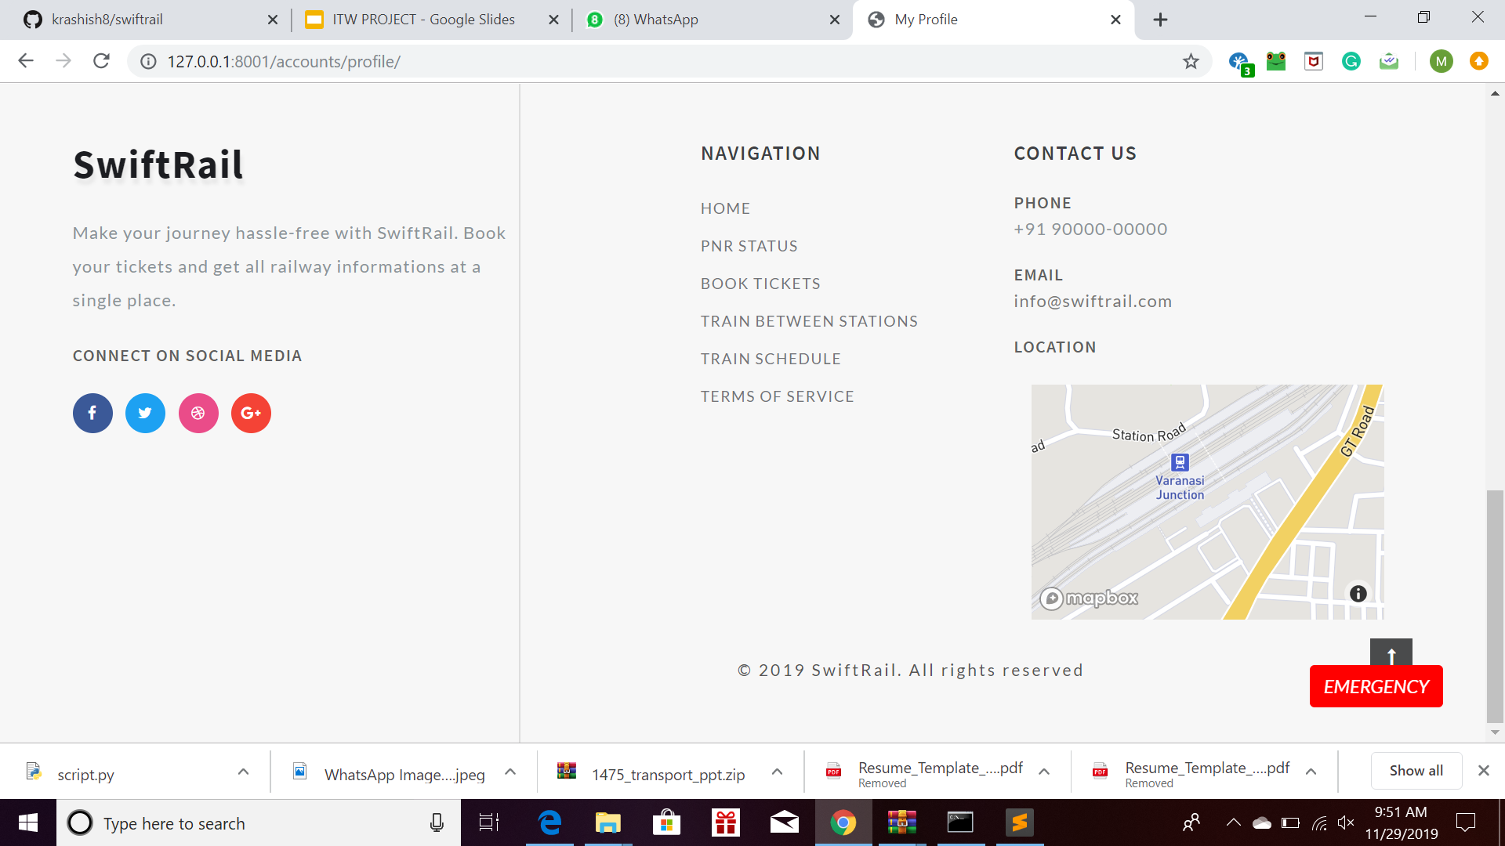
OTHER FEATURES
The Green circular icon denotes that the user is logged in with the first letter of the first name in it.
The zoomable location of Varanasi Junction station is displayed.
The Login with Google and Login with Facebook features allow the user feasibility in logging in on SwiftRail.

Slide 19
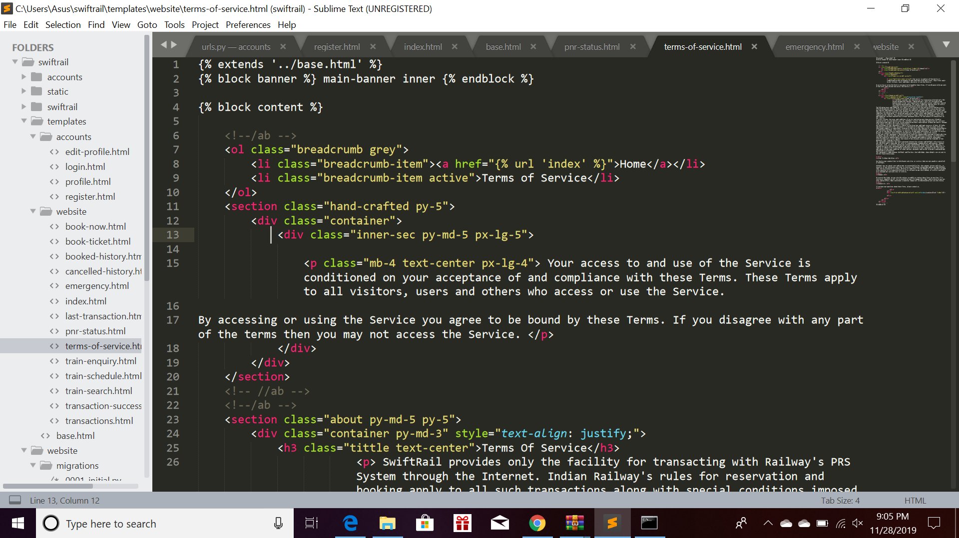
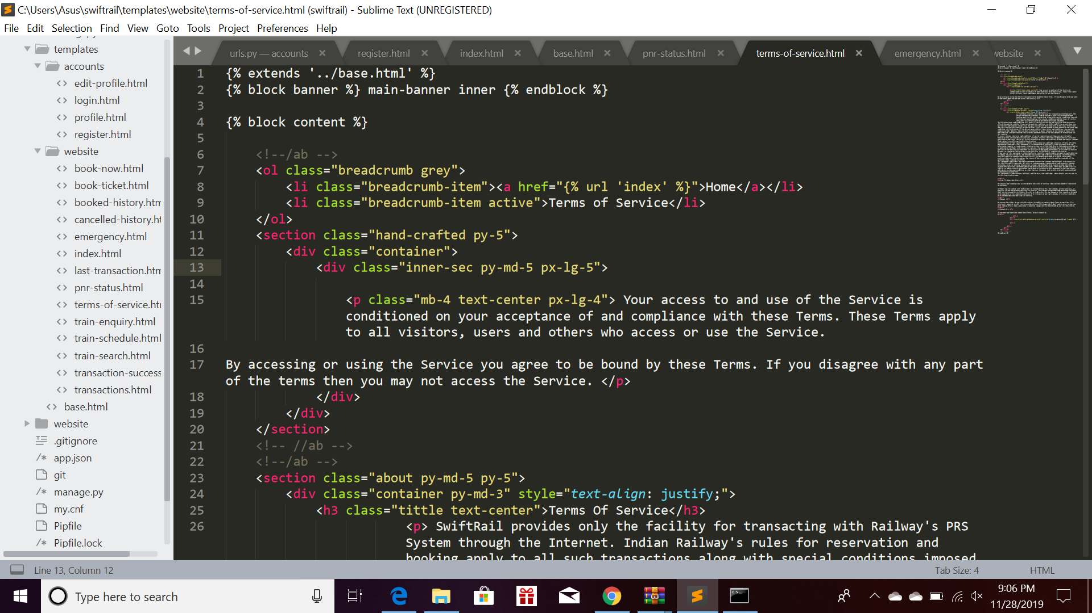
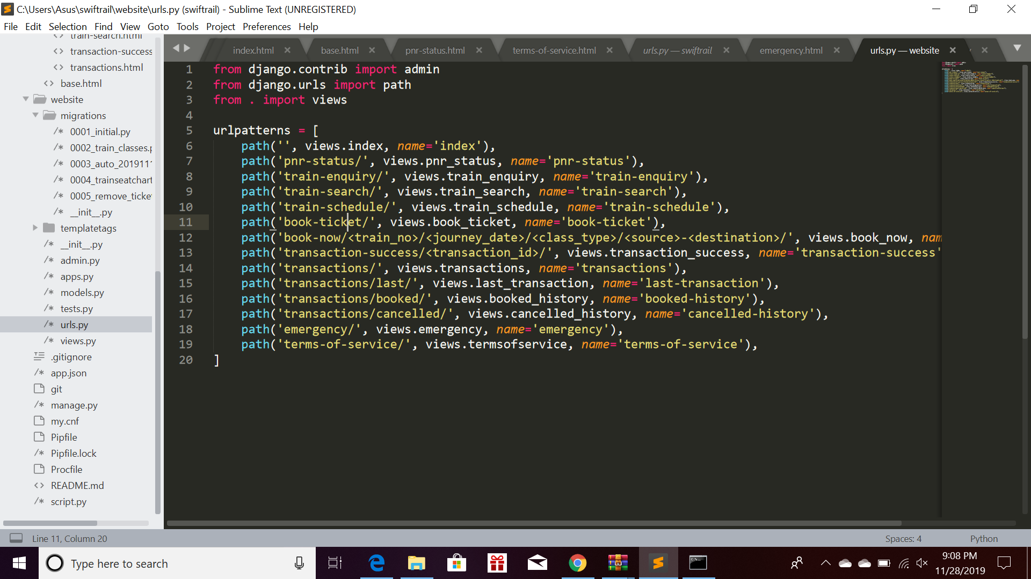
GLIMPSE INTO BACKEND

Slide 20
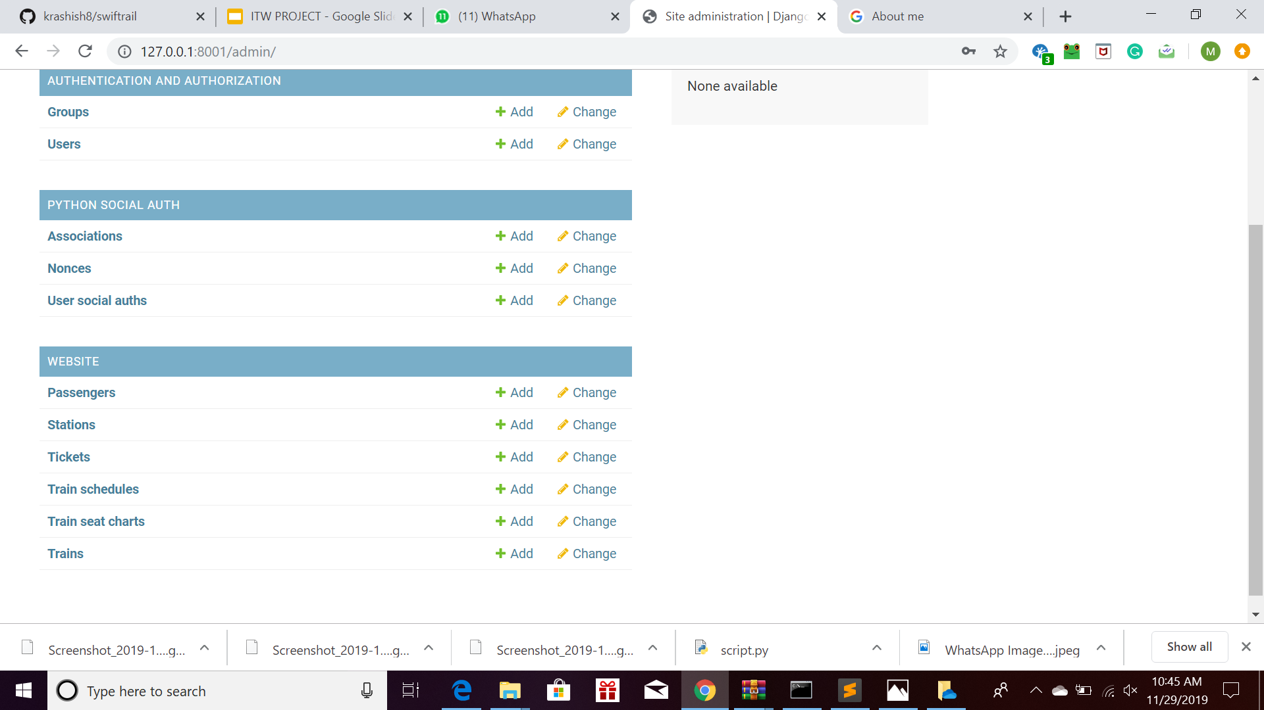
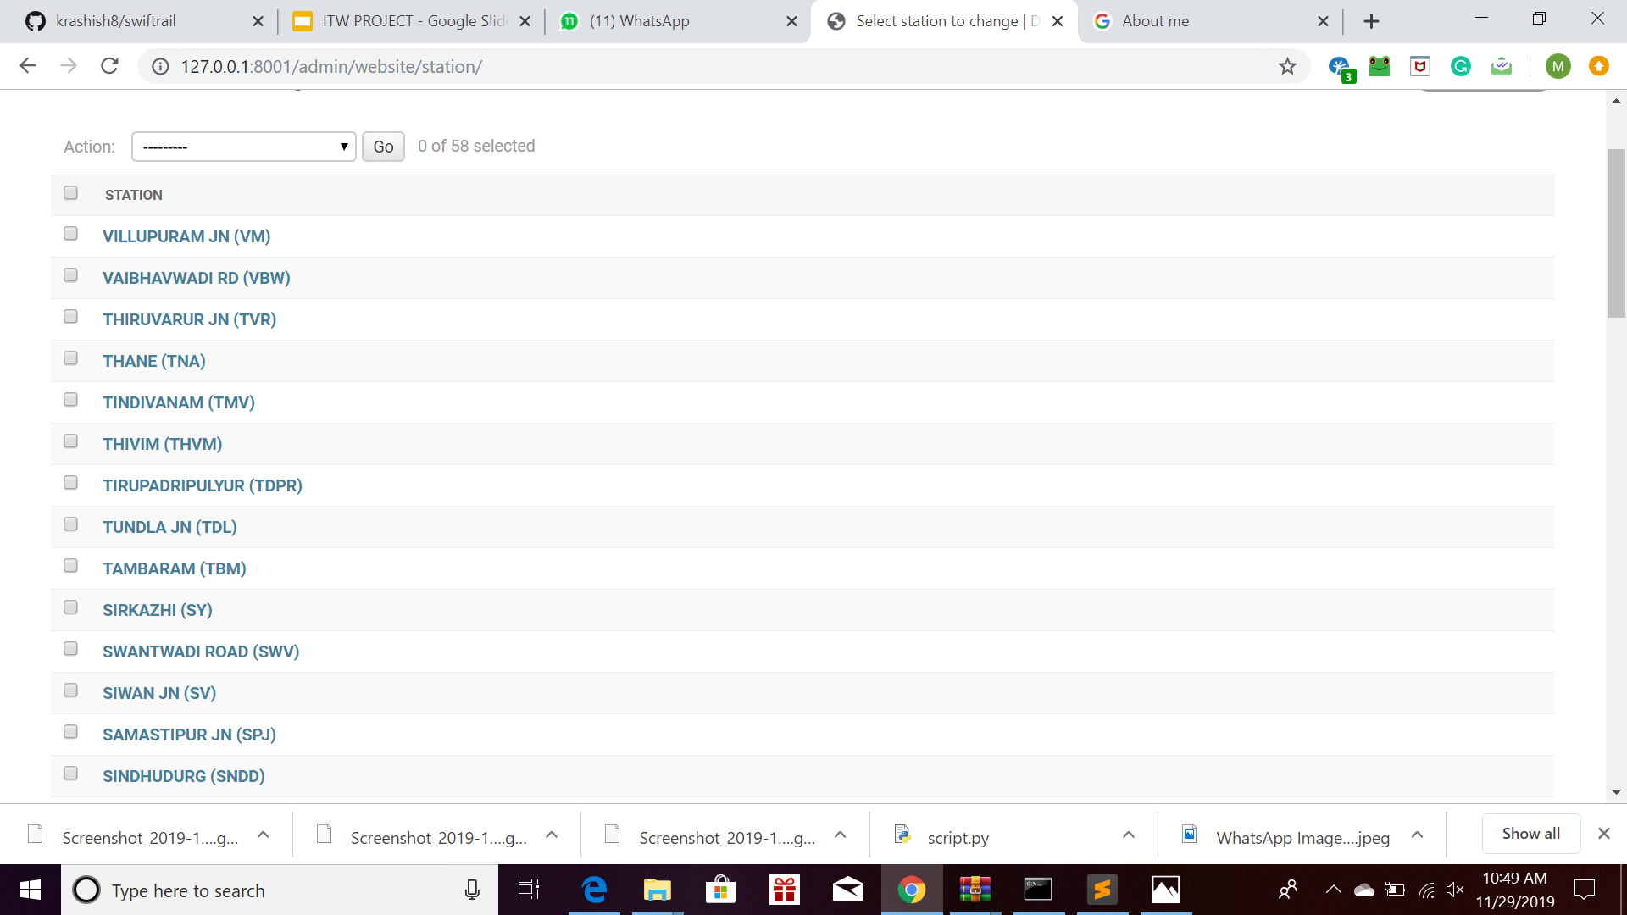
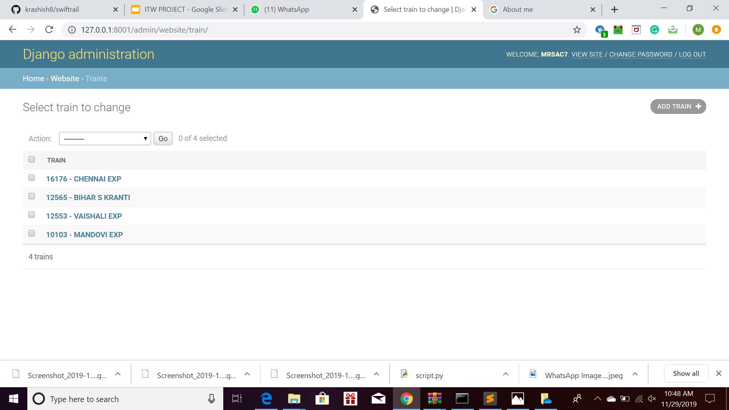
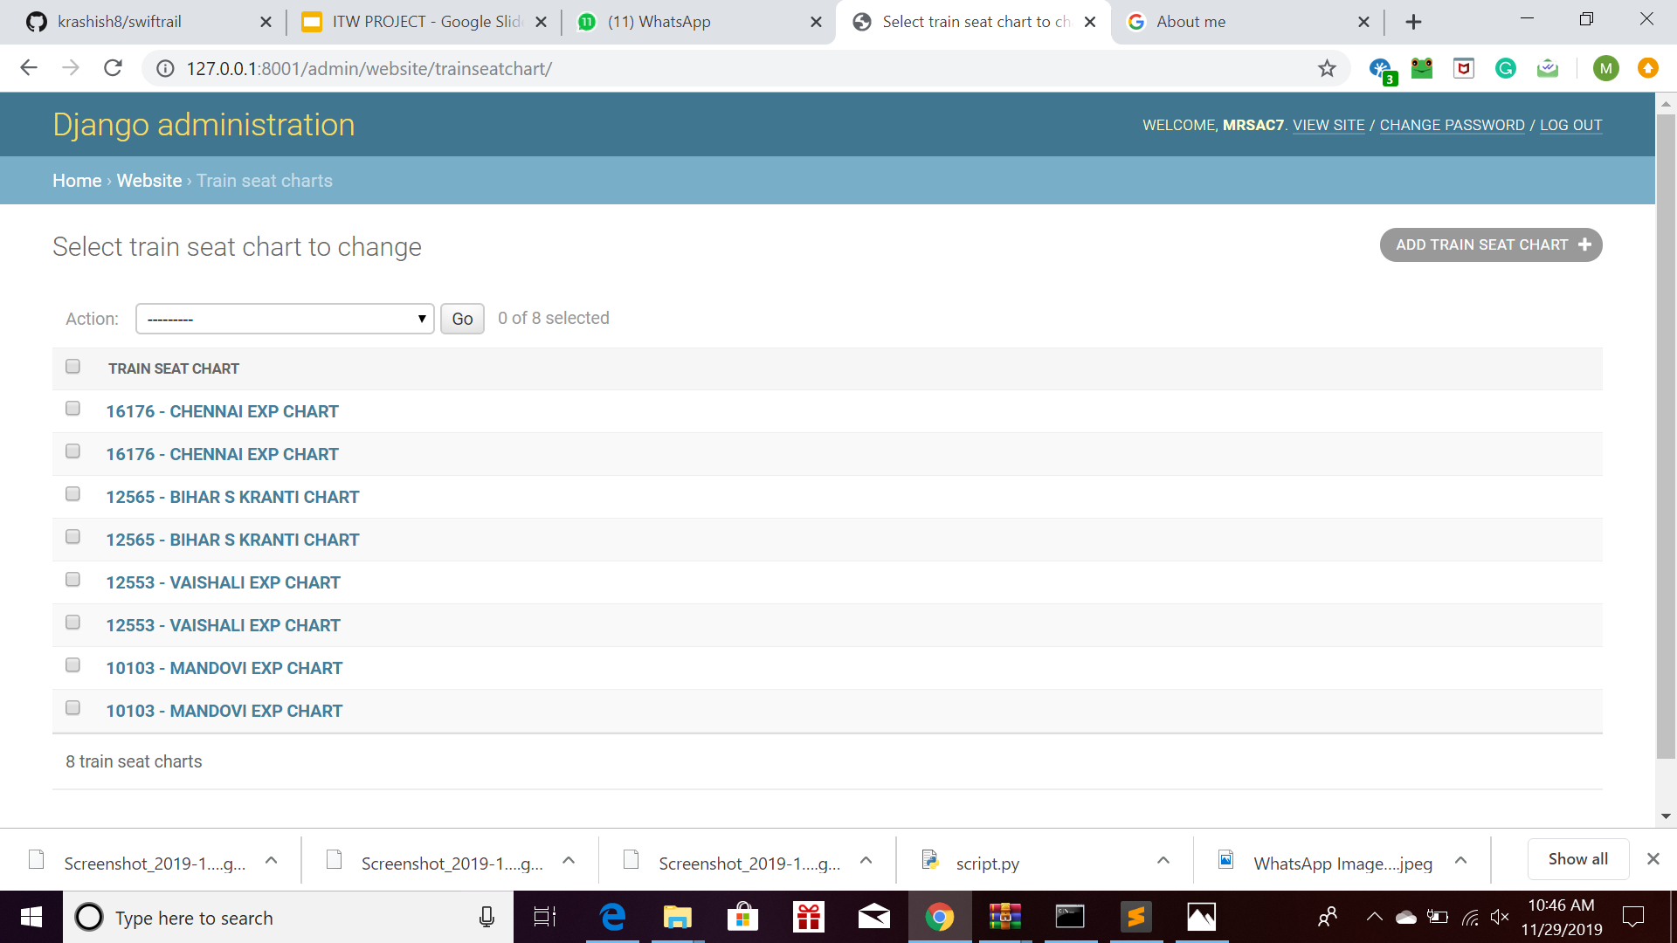
GLIMPSE INTO DATABASE

Slide 21
REQUIREMENTS
The requirements for this project are:
Python 3.7
Django 2.2.7 (Used as a backend)
Instamojo API (For Payment Gateway)
MySQL Client 1.4.4 (For Database)
Django Social Auth App (For Facebook Auth, Gmail Auth, etc)
Python Requests (For accessing Indian Rail API)

Slide 22
DATABASE DESIGN
We have used the following apps, with their respective models to store the data:
Accounts - For storing the profile details of the user.
Website - For storing the details of stations, trains, train schedules, train seat charts, tickets and passengers.
Auth User - For storing the login data of registered users.
Python Social Auth - For storing gmail auth and fb auth data.

Slide 23
PROJECT STRUCTURE
Accounts App:
Different Views used in this app are:
Login View (for user login)
Logout View (for user logout)
Register View (for registering the user)
Profile View (for creating profile of the user)
Create Profile View (for creating profile in case of social auth)

Slide 24
PROJECT STRUCTURE
Website App:
Different Views used in this app are:
Index View (for displaying homepage)
Terms of Service (for displaying terms of service)
Emergency (for displaying nearest station details)
PNR Status View (for displaying PNR Status)
Train Enquiry (for train enquiry)
Train Schedule (for getting train schedule by train number)
Train Search (for searching trains between two stations)

Slide 25
PROJECT STRUCTURE
Website App:
Different Views used in this app are:
Book Ticket (first step of ticket booking - for searching trains and displaying availability)
Book Now (final step of ticket booking - for writing the details of the passengers and payment gateway)
Transaction Success (for displaying booked ticket success)
Transactions (for displaying all transactions)
Last Transaction (for displaying last transaction)

Slide 26
PROJECT STRUCTURE
Website App:
Different Views used in this app are:
Booked History (for displaying history of booked tickets)
Cancelled History (for displaying history of cancelled tickets)
Live Status (for displaying live running status)
Ticket Cancel Page (for ticket cancel success page)

Slide 27
PROJECT STRUCTURE
Static folder: for static files (css, js, fonts, images)
Templates folder: (for html pages of accounts and website app)
base.html
Accounts App:
create-profile.html
login.html
profile.html
register.html
Website App:
booked-history.html
book-now.html

Slide 28
PROJECT STRUCTURE
Templates folder: (for html pages of accounts and website app)
Website App:
book-ticket.html
cancelled-history.html
emergency.html
index.html
last-transaction.html
live-status.html
pnr-status.html

Slide 29
PROJECT STRUCTURE
Templates folder: (for html pages of accounts and website app)
Website App:
terms-of-service.html
ticket-cancel-page.html
train-enquiry.html
train-schedule.html
train-search.html
transactions.html
transaction-success.html
script.py (script for adding data to database), my.cnf (config file), pipfile and pipfile.lock (for pipenv)

Slide 30
URL MAPPINGS
Accounts App: (/accounts/)
/login/
/logout/
/register/
/profile/
/create-profile/
/oauth/

Slide 31
URL MAPPINGS
Website App:
/
/pnr-status/
/live-status/
/train-enquiry/
/train-search/
/train-schedule/
/book-ticket/
/book-now/
/transaction-success/<transaction-id>/

Slide 32
URL MAPPINGS
Website App:
/transactions/
/transactions/last/
/transactions/booked/
/transactions/cancelled/
/emergency/
/terms-of-service/
/ticket-cancel-page/<pnr_no>/

Slide 33
TOOLS & TECHNOLOGIES
API Used:
Instamojo API - For Payment Gateway
Indian Rail API - For Live Train Status
Backend: Django 2.2.7 (Python 3.7)
Database: MySQL
Authentication (Django Social Auth) :
Facebook Auth
Gmail Auth
Python Requests (For Indian Rail API - GET requests)

Slide 34
REFERENCES
Official Python Documentation
Official Django Documentation
Instamojo API
Indian Rail API
Django Social Auth
Django Girls Tutorial
Simple Is Better Than Complex

Slide 35
CONTRIBUTORS
The students who contributed to this project are:
Ashish Kumar
B. Tech - 18075068
Sachin Srivastava
B. Tech - 18075070
Manav Mukesh Jain
IDD - 18074021

Slide 36

THANK YOU
Our project is available on GitHub as an Open Source project:
https://github.com/krashish8/swiftrail

